Slide 1
Walking the Path
~ Walking the Path of Forgiveness ~
Monday 31st March 2025
Brentwood Diocese Education Service

Slide 2
Trying to forgive like God does
“The first step to loving and forgiving as God does is to recognize that we cannot do it apart from Christ.”
BDES

Slide 3
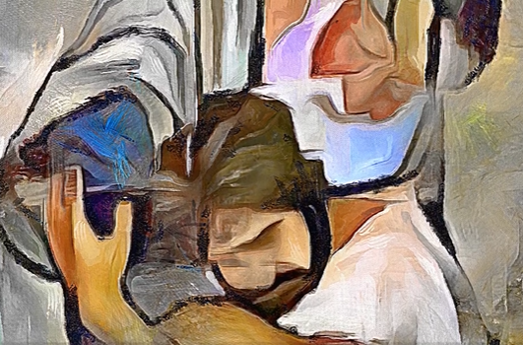
In Sunday’s Gospel Reading …
4th SUNDAY OF LENT 30th March 2025
In the Gospel of Luke,
we hear the words :
“You are always with me, and all I have is yours.”
BDES

Slide 4
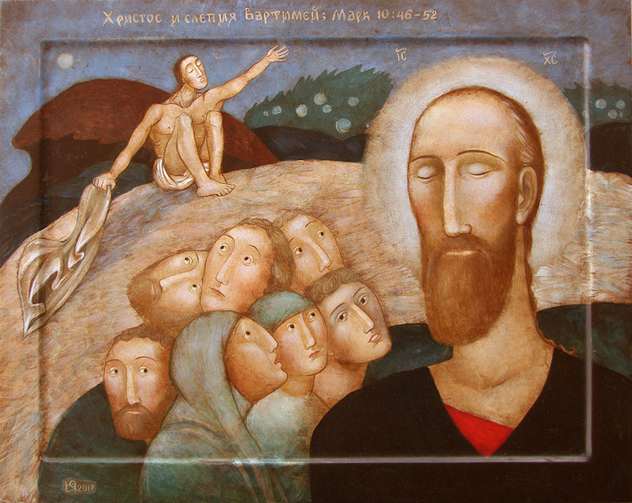
Reflection
CHRIST BE IN ALL THE EARS THAT HEAR ME SPEAK.
From the prayer known as
St Patrick’s Breastplate,
5th Century
BDES

Slide 5
Preparing for World Youth Day 2027
“Forgive always.”
- Pope Francis
BDES

Slide 6
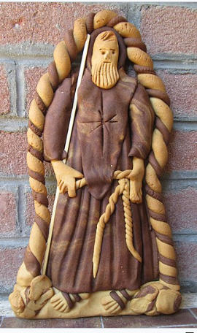
~ St Francis of Paola : 2nd April ~
St Francis (1416-1507) was a Franciscan friar from the town of Paola in Calabria, Italy. As a boy, he lived for a year in a Franciscan convent and then, at the age of 15 but with his parents’ permission, went to live as a hermit in a cave for six years. He was joined by others and eventually founded the Order of Minims, “the least of the faithful”; he went on to found other religious communities. From 1483 he lived in France as adviser to the king. The picture shows a ‘Nzuddha, a typical Calabrian honey cake, baked in the image of St Francis for his feast day.
BDES

Slide 7
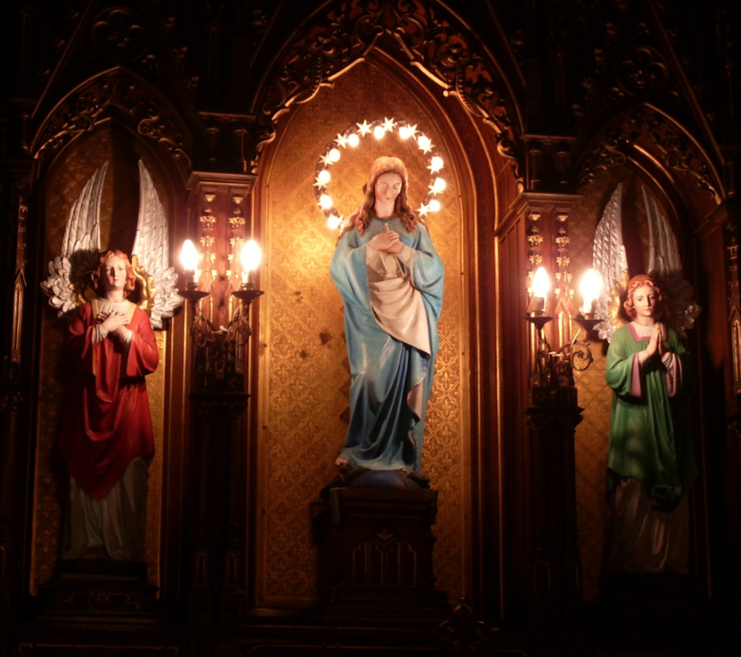
Rites of the Catholic Church # 5
THE BULGARIAN GREEK CATHOLIC CHURCH
This Church uses the Byzantine liturgical rite in the Bulgarian language and in the Bulgarian Cyrillic alphabet. It has one diocese : the Bulgarian Greek Catholic Eparchy of Sofia under Bishop (or Eparch) Christo Proykov.
The eparchy was set up as an Apostolic Exarchate in 1926 with the help of Archbishop Angelo Roncalli, the future Pope John XXIII. It has around 10,000 Catholics in 21 parishes, and Pope Francis made it a full eparchy in 2019.
The Byzantine Rite
BDES

Slide 8
Walking the Path
~ Walking the Path of Forgiveness ~
Monday 31st March 2025
Brentwood Diocese Education Service

