Slide 1
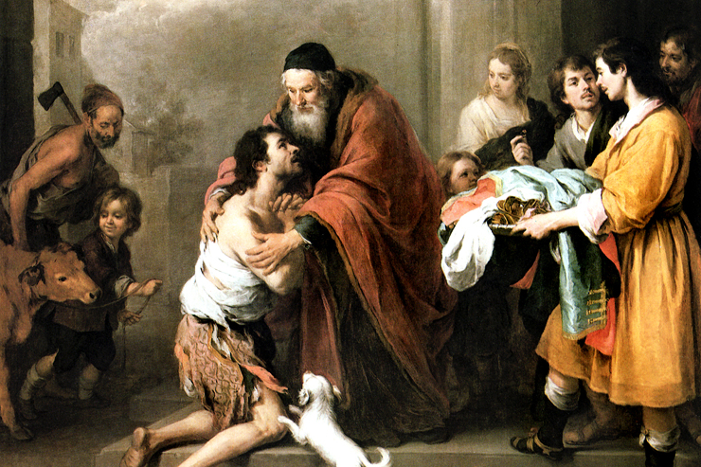
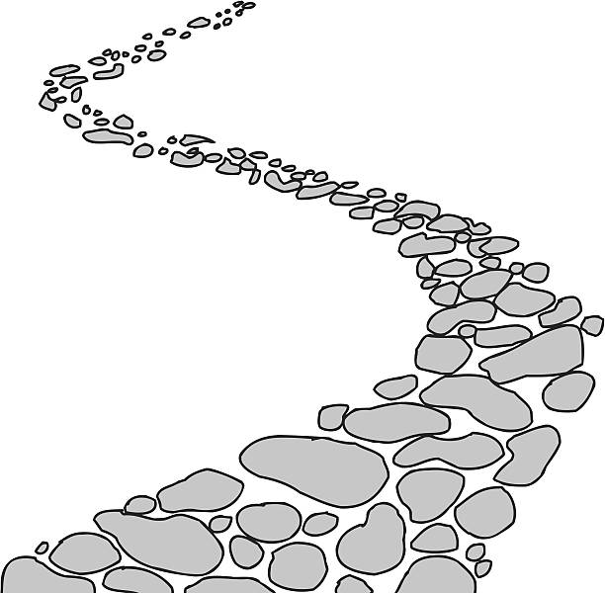
Walking the Path
~ Walking the Path of Forgiveness ~
Monday 24th February 2025
Brentwood Diocese Education Service

Slide 2
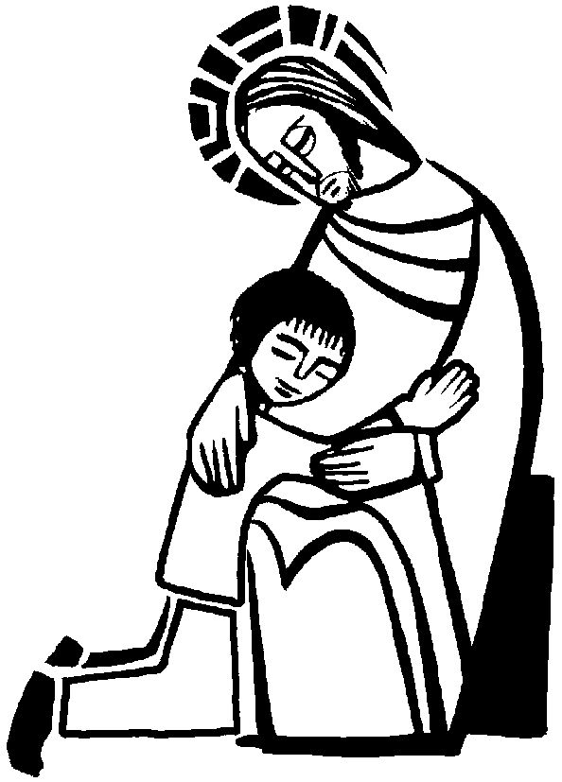
Walking the Path of Forgiveness
Forgiveness can help us heal.
Forgiveness means that we don’t have to be consumed by revenge or bitterness.
Forgiveness does allow us to move on, which is not the same as forgetting.
Forgiving someone else brings us freedom.
BDES

Slide 3
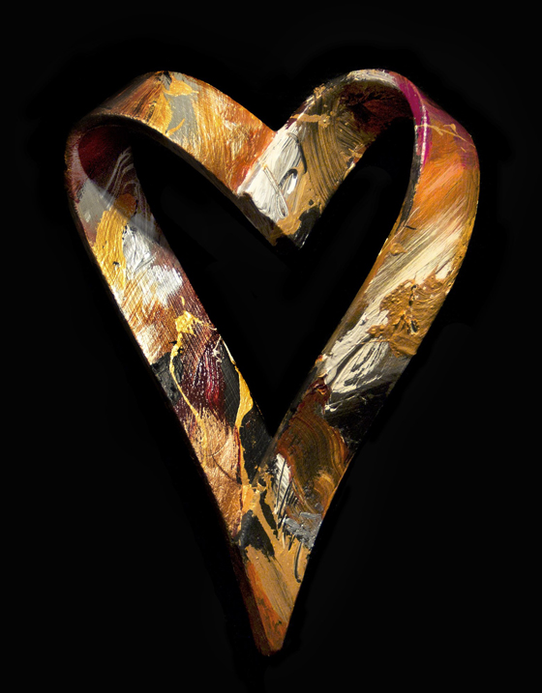
In Sunday’s Gospel Reading …
7th Sunday in Ordinary Time
Sunday 23rd February 2025
In the Gospel of Luke, Jesus tells us that we should
“Be merciful.”
BDES

Slide 4
Reflection
CHRIST
BE THERE
WHEN I SLEEP
AND
WHEN I RISE.
From the prayer known as
St Patrick’s Breastplate,
5th Century
BDES

Slide 5
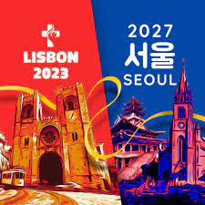
Preparing for World Youth Day 2027
“Each day, when we pray the Our Father, we say: ‘forgive us, as we forgive’.”
- Pope Francis.
BDES

Slide 6
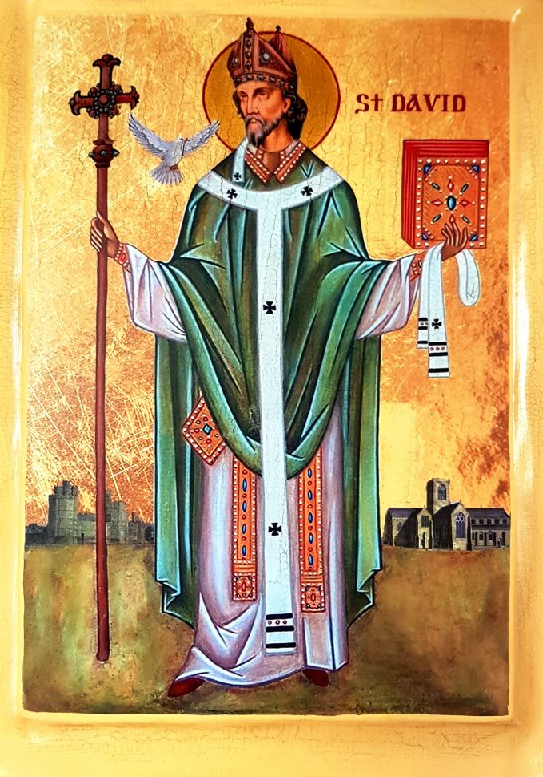
Saint David
National Feast Day
~ 1st March ~
“Gwnewch y pethau bychain” - “Do the little things”.
These are supposed to have been St David’s final words of advice on his deathbed, advice to live your life by small acts of kindness which together would make a large difference.
He is the patron saint of Wales and was a bishop there in the 6th century. He was a teacher, a preacher, a founder of monasteries and churches, an inspirational man who lived a simple life, and a visionary.
BDES

Slide 7
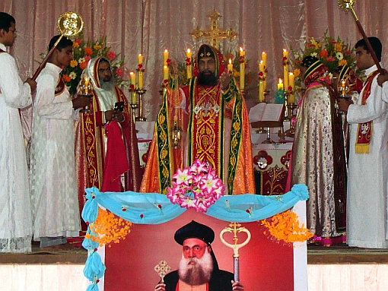
Rites of the Catholic Church # 3
This is an Eastern Catholic church in full communion with the worldwide Catholic Church possessing self-governance under the Code of Canons of the Eastern Churches. It is one of the major archepiscopal churches of the Catholic Church. It is headed by Major Archbishop Baselios Cardinal Cleemis Catholicos of the Major Archdiocese of Trivandrum based in Kerala, India. With more than 1,096 parishes, it is one of India's biggest church evangelical establishments. The Malankara Syrian Catholic Church traces its origins to the missions of Thomas the Apostle in the 1st century.
The Syro-Malankara Catholic Church
BDES

Slide 8
Walking the Path
~ Walking the Path of Forgiveness ~
Monday 24th February 2025
Brentwood Diocese Education Service

