Slide 1
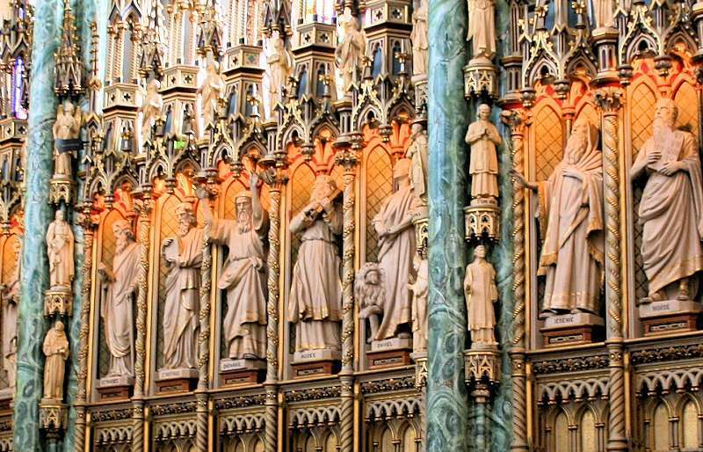
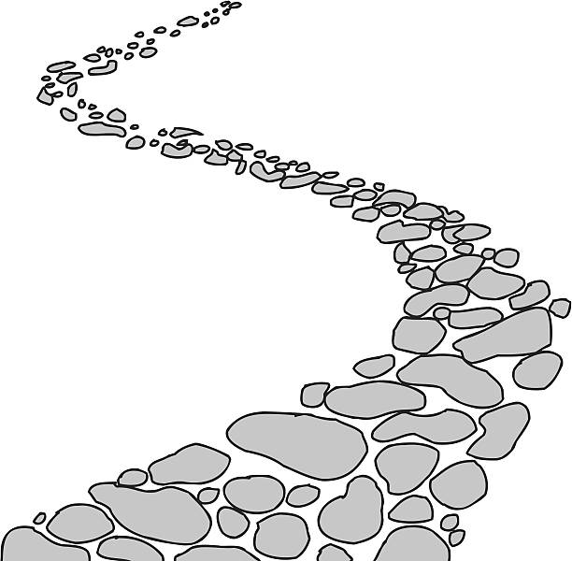
Walking the Path
~ Walking the Path of Saintliness ~
Monday 20th January 2025
Brentwood Diocese Education Service

Slide 2
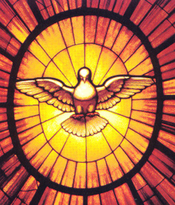
Walking the Path of Saintliness
Come, Holy Spirit, fill the hearts of your faithful.
And kindle in them the fire of your love.
Send forth your Spirit and they shall be created.
And you will renew the face of the earth.
Let us pray : O God, who by the light of the Holy Spirit,
did instruct the hearts of your faithful, grant that by that same Holy Spirit, we may be truly wise, and ever rejoice in your consolation, Through Christ our Lord.
Amen.
BDES

Slide 3
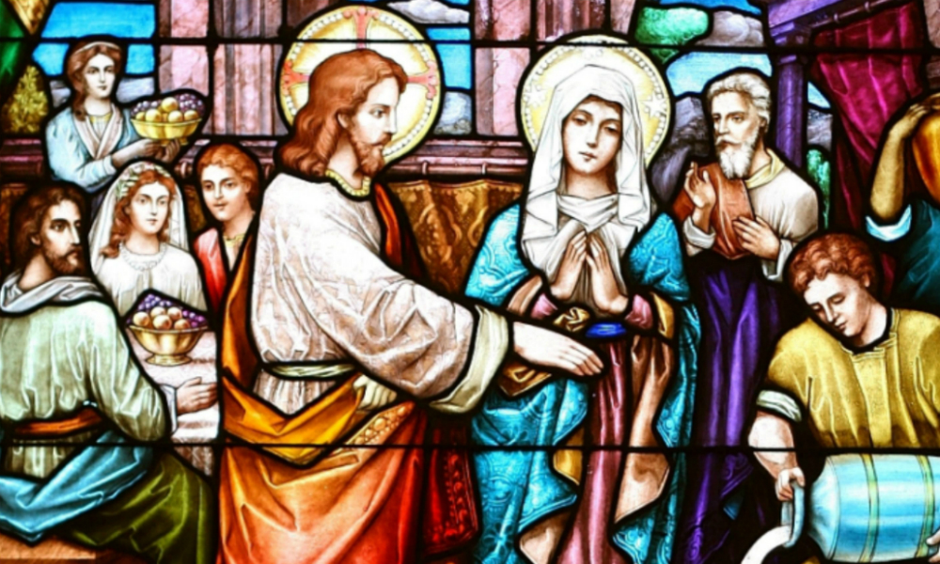
In Sunday’s Gospel Reading …
2nd Sunday in Ordinary Time
Sunday 19th January 2025
In the Gospel of John, Our Lady says :
“Do whatever he tells you.”
BDES

Slide 4
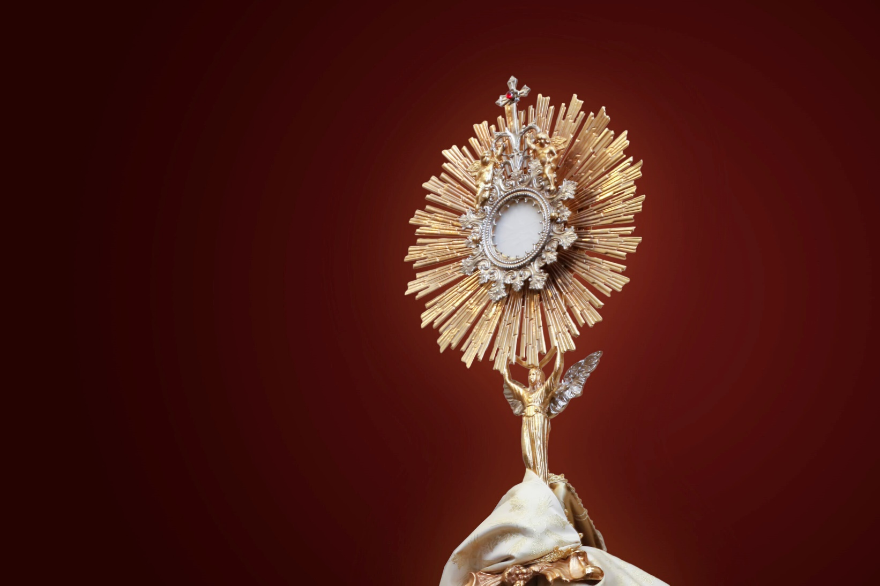
Reflection
CHRIST
BE
WITHIN
ME.
From the prayer known as
St Patrick’s Breastplate,
5th Century
BDES

Slide 5
Preparing for World Youth Day 2027
“Saints are those who are filled with God.”
- Pope Francis
BDES

Slide 6
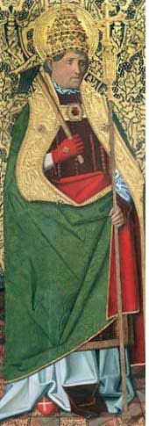
St Fabian: 20th January
St Fabian was a Pope and martyr who lived in the 3rd Century.
He was killed by the Roman Emperor Decius in an attempt to destroy the Church. His body was taken in procession to be buried in the catacombs below Rome in 250 AD. It was then moved to the church of St Sebastian by Pope Clement XI in the 18th Century.
Fabian had not sought to become Pope; he had not wanted high office but was elected Pope because of a miraculous sign. A dove descended on him showing that he was the choice of the Holy Spirit.
Becoming Pope meant that he was likely to be threatened and ultimately he died for his beliefs. He would not give up or renounce his faith and had lived a pure and holy life. He died on 20th January 250 AD.
BDES

Slide 7
Rites of the Catholic Church # 1
THE ETHIOPIAN CATHOLIC CHURCH
The Ethiopian Catholic Church is an autonomous Eastern Catholic Church, based in Ethiopia, which uses the Alexandrian Rite in Ge’ez (a local liturgical language).
The Church was established in 1930, and is organised by the Metropolitan Archbishop of Addis Ababa who accepts the universal jurisdiction of the pope.
In Ethiopia there are four Catholic dioceses, which are known as eparchies, in Addis Ababa, Adigrat, Bahir Dar-Dessie and Emdeber. Priests tend to dress in the Roman cassock and collar.
The Alexandrian Rite
BDES

Slide 8
Walking the Path
~ Walking the Path of Saintliness ~
Monday 20th January 2025
Brentwood Diocese Education Service

