Slide 1
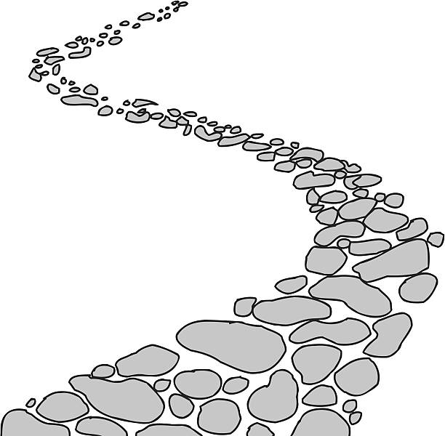
Walking the Path
~ Walking the Path of Courage ~
Monday 9th December 2024
Brentwood Diocese Education Service

Slide 2
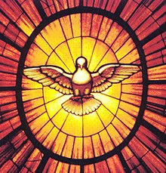
Walking the Path of Courage
“The seven gifts of the Holy Spirit are wisdom, knowledge, fear of God, understanding, right judgement, piety and COURAGE.
They help us to make decisions conforming with God’s will,
which is always
for our greatest good.”
BDES

Slide 3
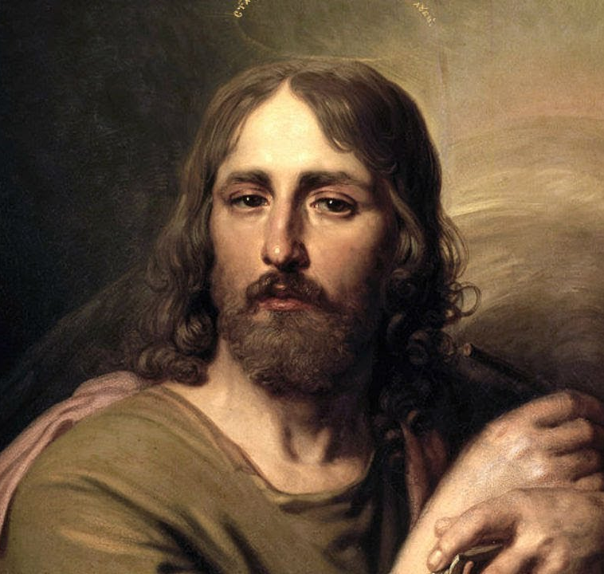
In Sunday’s Gospel Reading …
2nd Sunday of Advent
8th December 2024 :
In the Gospel of Luke,
we hear : :
“And his kingdom
shall have no end.”
BDES

Slide 4
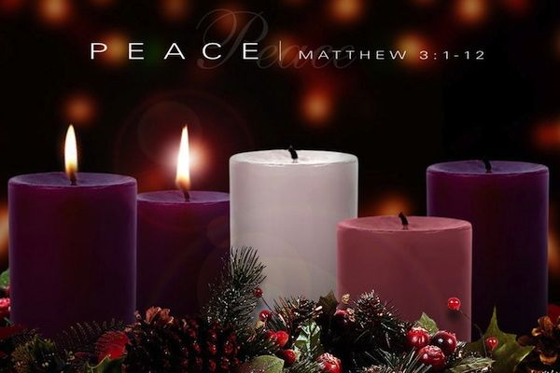
SECOND SUNDAY OF ADVENT
BDES

Slide 5
Letters of the New Testament # 6
From the 3rd Letter of St John :
“Nothing gives me
greater joy
than to hear that
my children are
walking in the truth.”
BDES

Slide 6
Preparing for World Youth Day 2027
“The path to
holiness takes courage.”
- Pope Francis (2022)
BDES

Slide 7
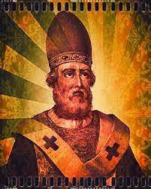
St. Damasus
Feast day :
11th December
Pope Damasus I c. 305 – 11th December 384, also known as Damasus of Rome, was the bishop of Rome from October 366 to his death. He presided over the Council of Rome in 382 that determined the canon or official list of sacred scripture. He spoke out against major heresies and solidified the faith of the Catholic Church, and encouraged the production of the Vulgate Bible (the Bible in the language of the people i.e. Latin) with his support for the translator St Jerome. He helped reconcile the Church of Rome and the Church of Antioch, and encouraged the veneration of martyrs.
BDES

Slide 8
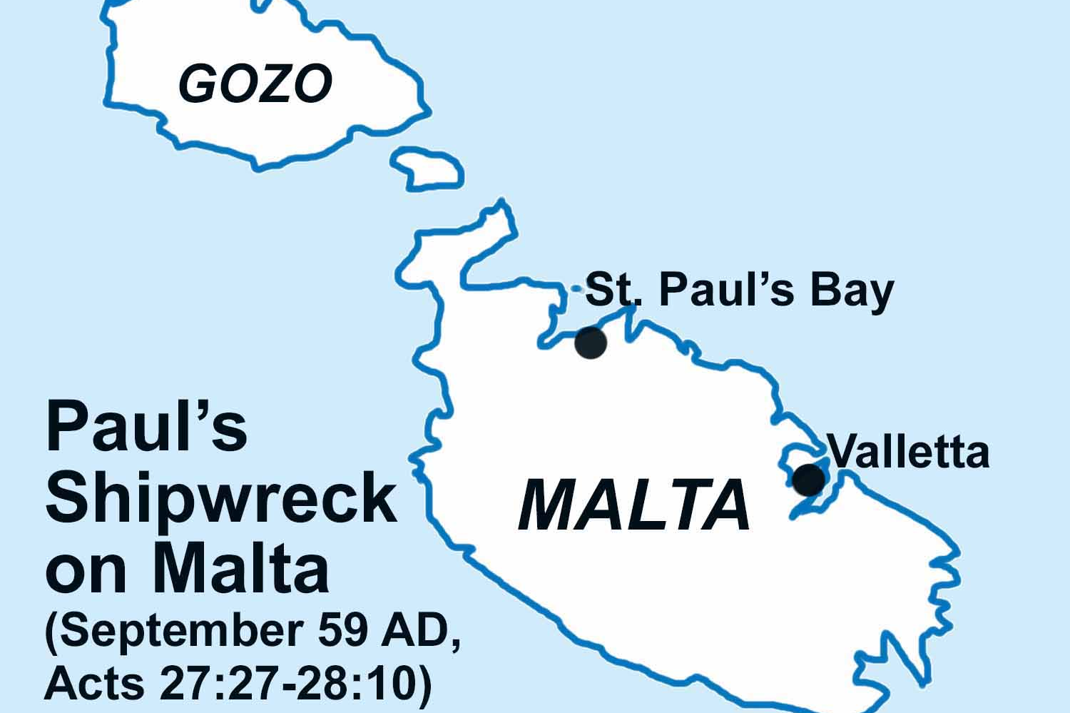
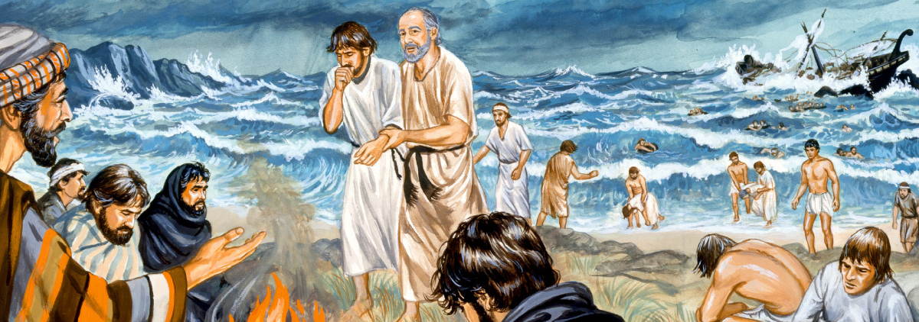
St Paul’s Missionary Journeys
On his way to Rome to face charges in 60 AD, St Paul was shipwrecked on Malta. Traditionally, St Paul’s Bay is identified as the location for this disaster. The islanders showed the victims of the shipwreck great kindness.
# 6 : Malta
BDES

Slide 9
Walking the Path
~ Walking the Path of Courage ~
Monday 9th December 2024
Brentwood Diocese Education Service

