Slide 1
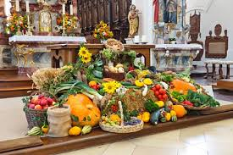
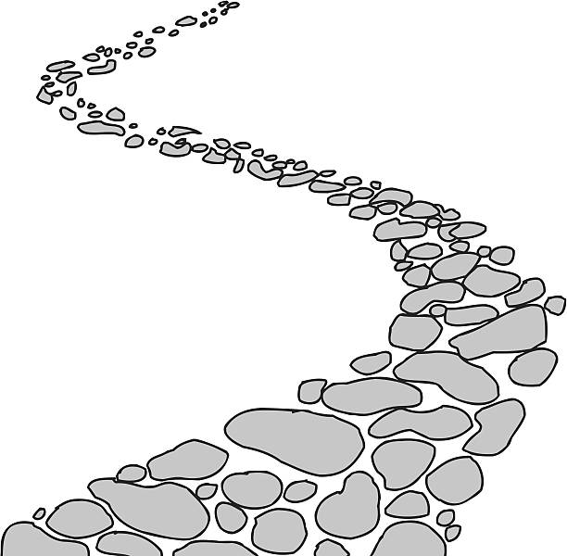
Walking the Path
~ Walking the Path of Solidarity ~
Monday 23rd September 2024
Brentwood Diocese Education Service

Slide 2
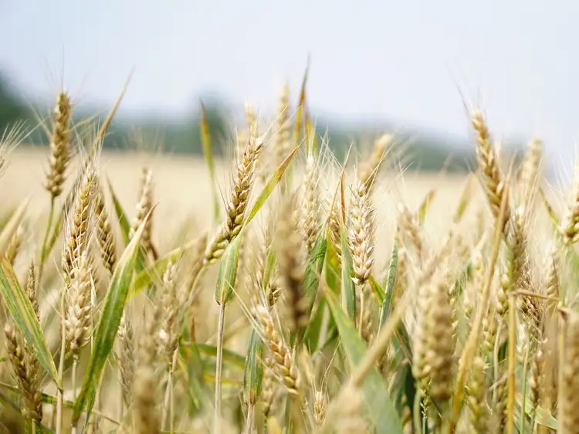
Walking the Path of Solidarity
Praise be to you, O God, source of life and goodness. You fill the earth with abundance and love all that you have made. As we join creation
in singing your glory, teach us to care for
our common home.
Amen
BDES

Slide 3
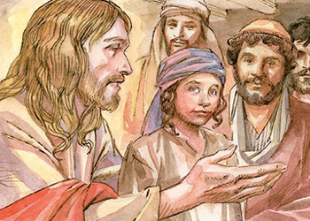
In Sunday’s Gospel Reading …
25th Sunday of Ordinary Time
22nd September 2024
In the Gospel of Mark,
Jesus tells us :
“If anyone wishes to be first, he shall be the last of all and the servant of all.”
BDES

Slide 4
From St Paul’s Letters # 4
Letter to the Ephesians
“Walk in love,
as Christ loved us
and gave himself up
for us.”
BDES

Slide 5
Preparing for World Youth Day 2027
“As Christians, let us always make charity, faith and hope the basis of our lives and our actions.”
- Pope Francis,
(World Day of the Poor, 2022)
BDES

Slide 6
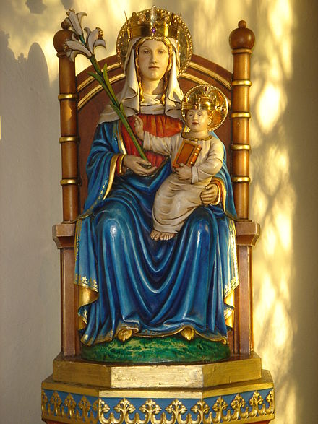
0
Feast Day of Our Lady of Walsingham
Walsingham has had a famous shrine to Our Lady since 1061. It was one of the great places of pilgrimage in the Middle Ages.
In a Marian apparition the Blessed Virgin Mary fetched Richeldis’ soul from England to Nazareth to show the house where the Holy Family once lived and in which the Annunciation of Archangel Gabriel occurred. Richeldis was given the task of building a replica house in her village, in England which came to be known as the "Holy House", and later became both a shrine and a focus of pilgrimage to Walsingham. In 1538 the King’s Commissioners destroyed the Shrine and burned the statue of Our Lady.
In 1897 the Sanctuary of Our Lady of Walsingham was restored and rebuilt, and pilgrimages began again.
24th September
BDES

Slide 7
Act of Love
My God,
because you are so good,
I love you
with all my heart,
and for your sake,
I love my neighbour
as myself.
BDES

Slide 8
Walking the Path
~ Walking the Path of Solidarity ~
Monday 23rd September 2024
Brentwood Diocese Education Service

