Slide 1
Walking the Path
~ Walking the Path of Solidarity ~
Monday 16th September 2024
Brentwood Diocese Education Service

Slide 2
Walking the Path of Solidarity
“Solidarity does not assume that our struggles are the same struggles,
or that our pain is the same pain, or that our hope is for the same future. Solidarity involves commitment, and work,
as well as the recognition that
even if we do not have the same feelings,
or the same lives, or the same bodies,
we do live on common ground.”
- Sara Ahmed, The Cultural Politics of Emotion
BDES

Slide 3
In Sunday’s Gospel Reading …
15th September 2024
In the Gospel of Mark, Jesus asks his friends :
“Who do you say I am?”
BDES

Slide 4
EVANGELII GAUDIUM SUNDAY
“God does not hide himself from those who seek him with a sincere heart.”
The Joy of the Gospel
BDES

Slide 5
From St Paul’s Letters # 3
Letter to the Galatians
“In Christ Jesus
you are all
children of God
through faith.”
BDES

Slide 6
Preparing for World Youth Day 2027
“Let us continue to uphold the values of freedom, responsibility, fraternity, and solidarity.”
- Pope Francis,
World Day of the Poor, 2022
BDES

Slide 7
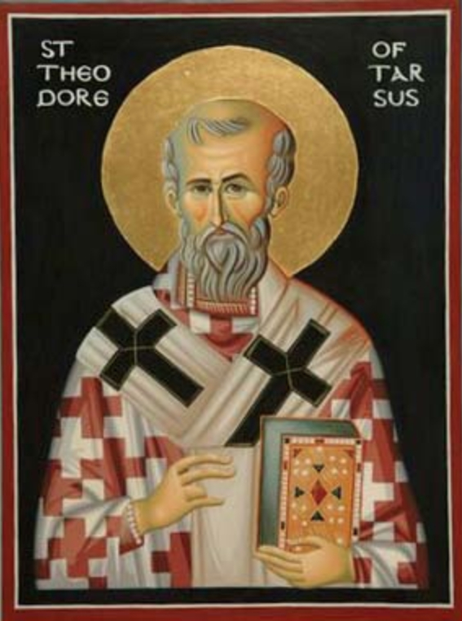
St Theodore of Canterbury
Theodore, like St Paul, came from Tarsus on the Black Sea. He was a highly-educated monk living in Rome who was quickly advanced through all the clerical ranks and consecrated as Archbishop of Canterbury at the age of 65 in 668 AD. He remained in office until his death at the age of 87. Despite his advanced age, and beginning his ministry as archbishop when today most people are retired, he was hugely energetic and travelled the length and breadth of England, settling disputes, founding churches, consecrating bishops, establishing a school at Canterbury and summoning the first Church council in England.
19th September
BDES

Slide 8
Act of Hope
My God,
I hope in you,
for grace and for glory,
because of your promises,
your mercy
and your power.
BDES

Slide 9
Walking the Path
~ Walking the Path of Solidarity ~
Monday 16th September 2024
Brentwood Diocese Education Service

