Slide 1



Walking the Path
~ Walking the Path of the Spirit ~
Monday 24th June 2024
Brentwood Diocese Education Service

Slide 2
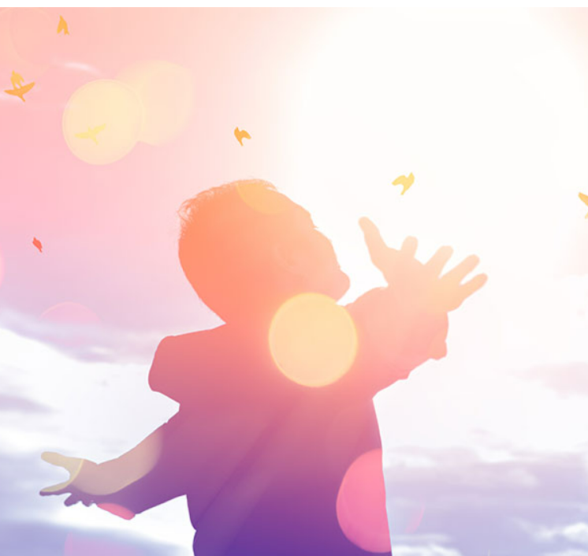
Walking the Path of the Spirit
“Since we live by the Spirit,
let us walk with the Spirit.”
(Galatians 5 : 25)
BDES

Slide 3
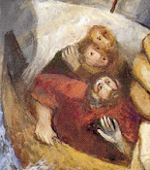
In Sunday’s Gospel Reading …
23rd June 2024
In the Gospel of Mark, we hear that :
“They were overcome with awe.”
BDES

Slide 4

Virtues for Catholic Schools
JUSTICE
“Let justice roll on like a river.”
(Amos 5 : 24)
BDES

Slide 5

Preparing for World Youth Day 2027
“Charity is the work of the Holy Spirit in us.”
- Pope Francis,
General Audience,
15th May 2024
BDES

Slide 6
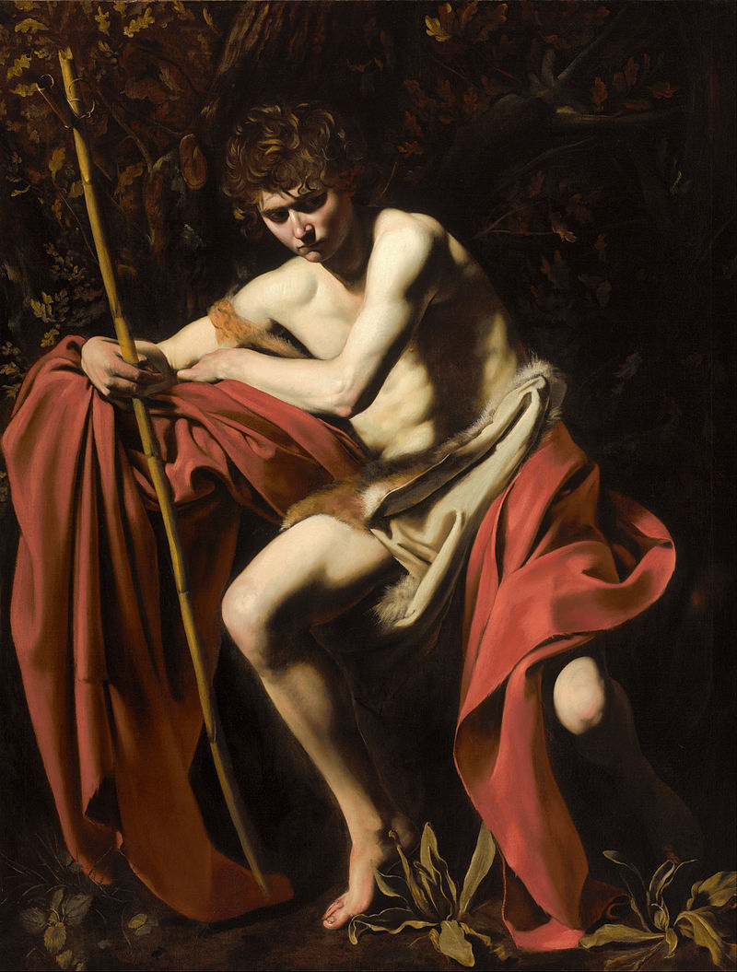
Feast of the Nativity of St John the Baptist
St John the Baptist was a preacher who according to the Gospels fulfilled the prophecy of Isaiah which described a voice crying in the wilderness.
The Gospel of Luke shows Mary visiting John’s mother Elizabeth and the child in her womb leapt for joy.
John spent his time preaching and baptising.
He is subsequently executed by beheading at the instruction of Herod.
23rd June
BDES

Slide 7

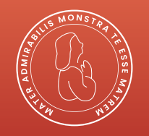
Come, Holy Spirit
Come, Holy Spirit, fill the hearts of your faithful.
And kindle in them the fire of your love.
Send forth your Spirit and they shall be created.
And you will renew the face of the earth.
Let us pray : O God, who by the light of the Holy Spirit, did instruct the hearts of your faithful, grant that by that same Holy Spirit, we may be truly wise, and ever rejoice in your consolation, Through Christ our Lord.
Amen.
BDES

Slide 8
Walking the Path
~ Walking the Path of the Spirit ~
Monday 24th June 2024
Brentwood Diocese Education Service

