Slide 1
Walking the Path
~ Walking the Path of the Spirit~
Monday 17th June 2024
Brentwood Diocese Education Service

Slide 2
Walking the path of the Spirit
Prayers to the Holy Spirit
“Holy Spirit, make my heart open to the word of God, make my heart open to goodness, make my heart open to the beauty of God every day.”
Pope Francis 2013
BDES

Slide 3
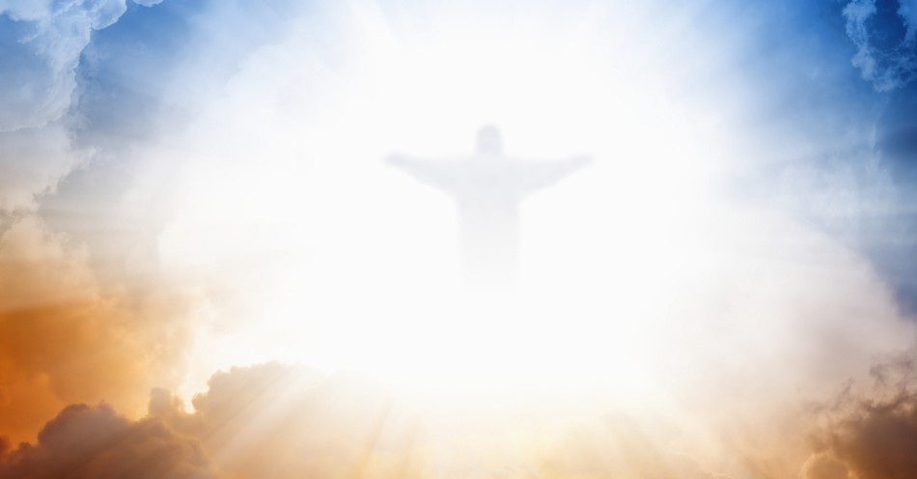
In Sunday’s Gospel Reading …
16th June 2024 :
The Gospel of Mark,
Jesus asks :
“What can we say
the kingdom of God
is like?”
BDES

Slide 4
Virtues for Catholic Schools
LOVE
“Love does not rejoice at wrongdoing, but finds its joy in the truth.
It is always ready to make allowances, to trust, to hope and to endure whatever comes.”
(1 Corinthians 13: 6-7)
BDES

Slide 5
Preparing for World Youth Day 2027
“The Holy Spirit is the engine of evangelisation.”
- Pope Francis,
(General Audience, 22nd February 2023)
BDES

Slide 6
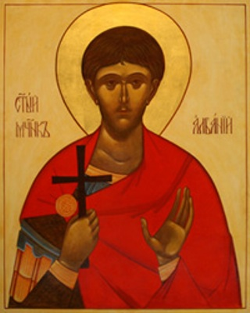
St Alban of Verulamium: Feast Day 20th June
Alban was a citizen of Verulamium – an important Roman city close to present-day St Albans. He took in a Christian priest, Amphibalus, fleeing the Roman persecution of Christians. The prayer and life of the priest so impressed Alban that he accepted the Christian faith.
When the Roman authorities discovered Amphibalus, Alban exchanged clothes with him and he escaped. Alban was brought before a judge, declared his Christian faith and though tortured, refused to sacrifice to the Roman gods. As a result he was sentenced to death, the first English martyr.
BDES
BDES

Slide 7
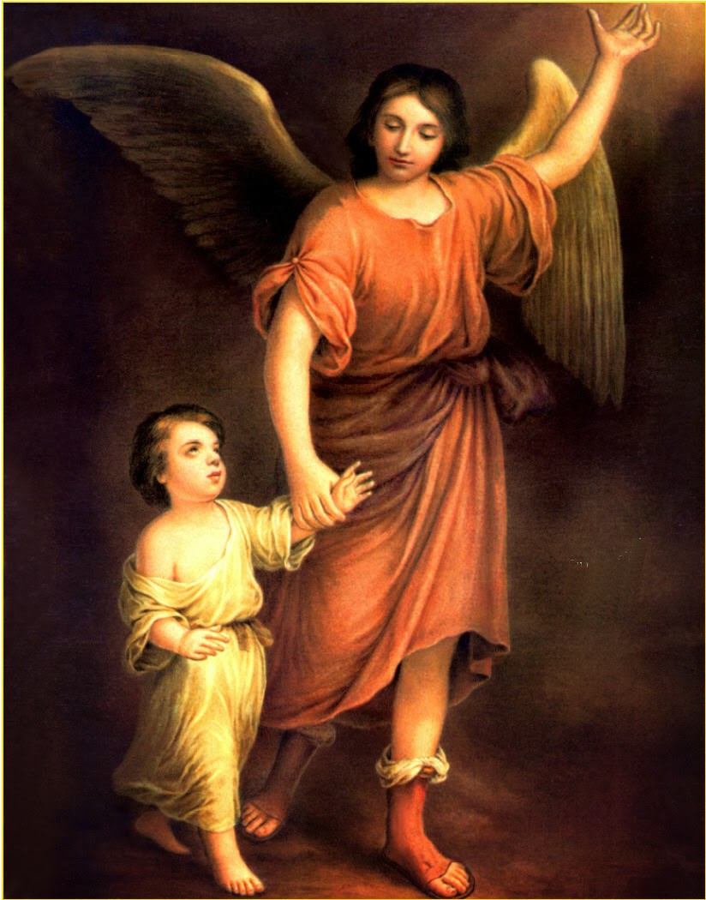
Angel of God
Angel of God, my guardian dear, to whom God's love commits me here, ever this day be at my side, to light and guard, to rule and guide.
Amen.
BDES

Slide 8
Walking the Path
~ Walking the Path of the Spirit~
Monday 17th June 2024
Brentwood Diocese Education Service

