Slide 1
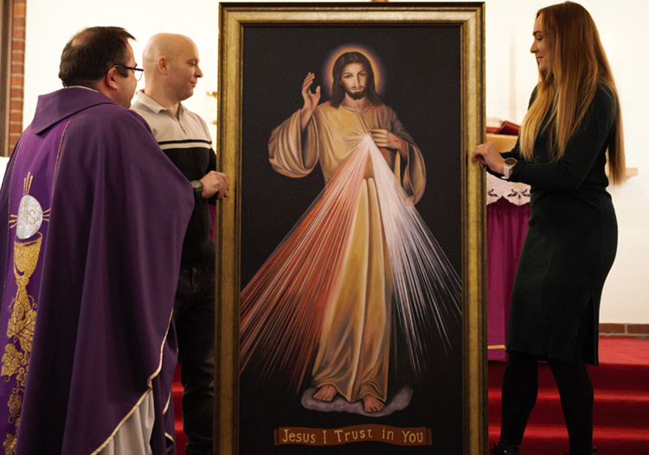
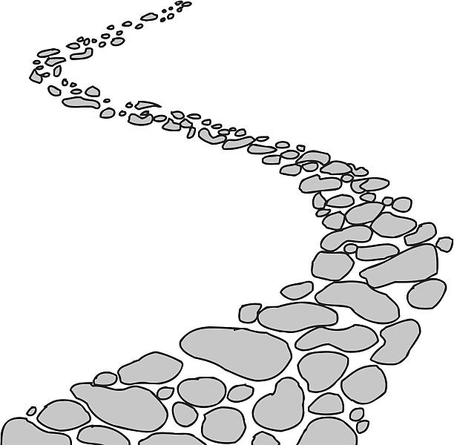
Walking the Path
~ Walking the Path of the Spirit~
Monday 3rd June 2024
Brentwood Diocese Education Service

Slide 2
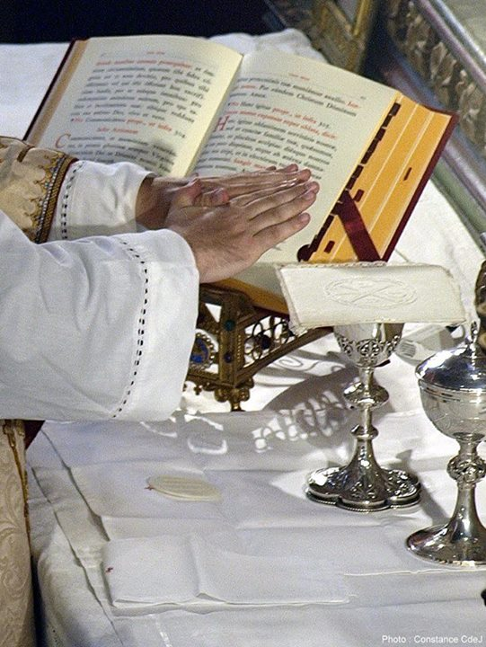
Walking the path of the Spirit
Praying to the Holy Spirit
He teaches us the path, the way.
In the early times of the Church,
Christianity was called “the way” (Acts 9:2), and Jesus himself is the Way.
The Holy Spirit teaches us to follow him,
to walk in his footprints.
(from Hallow)
J.O.Y. ~ Loving Jesus, Loving Others, Loving Yourself..
BDES

Slide 3
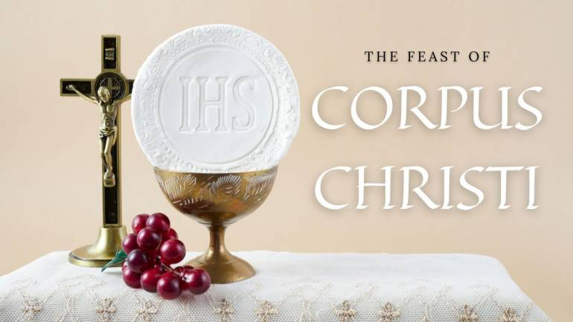
In Sunday’s Gospel Reading …
The Most Holy
Body and Blood of Christ:
2nd June 2024 :
In the Gospel, Christ tells his friends : :
“This is my Body.”
BDES

Slide 4
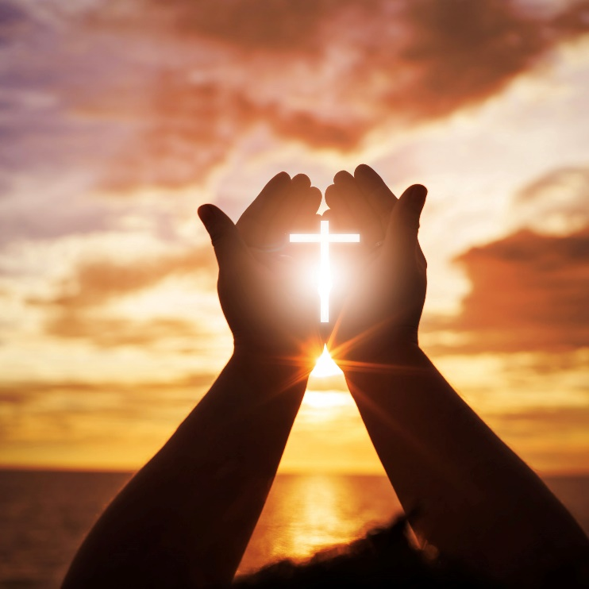
Reflection
Consider the virtue of FAITH.
Let us be faithful to Jesus.
Let us have faith
in others and ourselves.
BDES

Slide 5
Preparing for World Youth Day 2027
“Let us start anew from the Holy Spirit.”
- Pope Francis
(General Audience, 22nd February 2023)
BDES

Slide 6
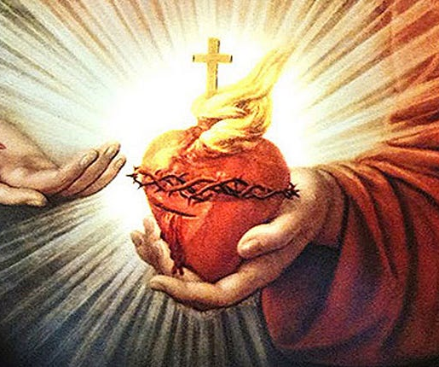
Solemnity of the
~ Sacred Heart of Jesus ~
The Most Sacred Heart of Jesus is where the heart of Jesus Christ is viewed as a symbol of “God's boundless and passionate love for mankind”. The Solemnity of the Most Sacred Heart of Jesus is celebrated on the third Friday after Pentecost. The devotion is especially concerned with what the church deems to be the long-suffering love and compassion of the heart of Christ towards humanity. The popularisation of this devotion in its modern form is derived from a Roman Catholic nun from France, Margaret Mary Alacoque, and later, in the 19th century, from the mystical revelations of another Catholic nun in Portugal, Mary of the Divine Heart.
BDES

Slide 7
The Apostles’ Creed
I believe in God, the Father Almighty, Creator of heaven and earth, and in Jesus Christ, His only Son, our Lord, who was conceived by the Holy Spirit, born of the Virgin Mary, suffered under Pontius Pilate, was crucified, died and was buried; He descended into hell;
on the third day He rose again from the dead; He ascended into heaven, and is seated at the right hand of
God the Father Almighty; from there He will come to judge
the living and the dead. I believe in the Holy Spirit, the Holy Catholic Church, the communion of Saints, the forgiveness of sins, the resurrection of the body, and life everlasting. Amen
BDES

Slide 8
Walking the Path
~ Walking the Path of the Spirit~
Monday 3rd June 2024
Brentwood Diocese Education Service

