Slide 1
The Sign of the Cross
In the name of the Father
and of the Son
and of the Holy Spirit.
Amen.
BDES

Slide 2
Our Father
Our Father,
Who art in Heaven,
Hallowed be Thy name.
Thy Kingdom come,
Thy Will be done on earth as it is in Heaven.
Give us this day our daily bread,
and forgive us our trespasses,
as we forgive those who trespass against us, and lead us not into temptation,
but deliver us from evil.
Amen
BDES

Slide 3
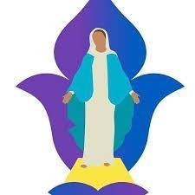
Hail Mary
Hail Mary, full of grace, the Lord is with thee;
blessed art thou among women and blessed is the fruit of thy womb, Jesus.
Holy Mary, Mother of God, pray for us sinners, now and at the hour of our death. Amen
BDES

Slide 4
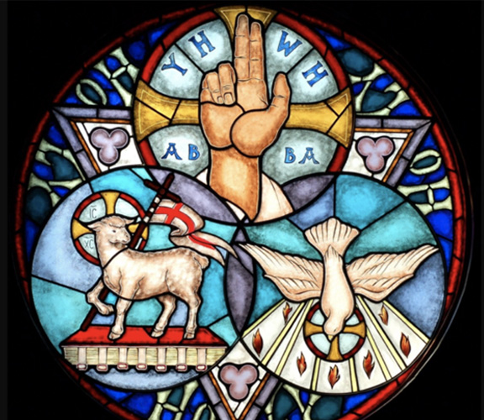
Glory be to the Father
Glory be to the Father,
and to the Son
and to the Holy Spirit,
as it was in the beginning,
is now, and ever shall be,
world without end.
Amen
BDES

Slide 5
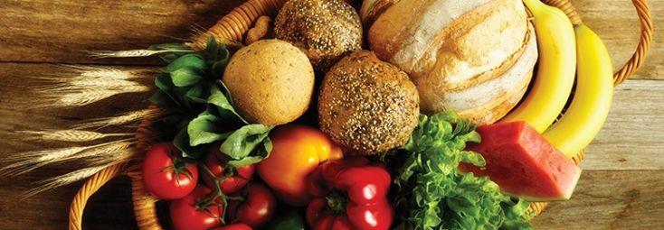
Grace Before Meals
Bless us, O Lord, and these your gifts
which we are about to receive from your bounty. Through Christ our Lord. Amen
BDES

Slide 6
Grace After Meals
We give you thanks, Almighty God, for all your benefits, who live and reign, world without end. Amen.
BDES

Slide 7
The Apostles’ Creed
I believe in God, the Father Almighty, Creator of heaven and earth, and in Jesus Christ, His only Son, our Lord, who was conceived by the Holy Spirit, born of the Virgin Mary, suffered under Pontius Pilate, was crucified, died and was buried; He descended into hell;
on the third day He rose again from the dead; He ascended into heaven, and is seated at the right hand of
God the Father Almighty; from there He will come to judge
the living and the dead. I believe in the Holy Spirit, the Holy Catholic Church, the communion of Saints, the forgiveness of sins, the resurrection of the body, and life everlasting. Amen
BDES

Slide 8
An Act of Contrition
O my God,
because you are so good,
I am very sorry that I have sinned against you,
and with the help of your grace I will not sin again.
BDES

Slide 9
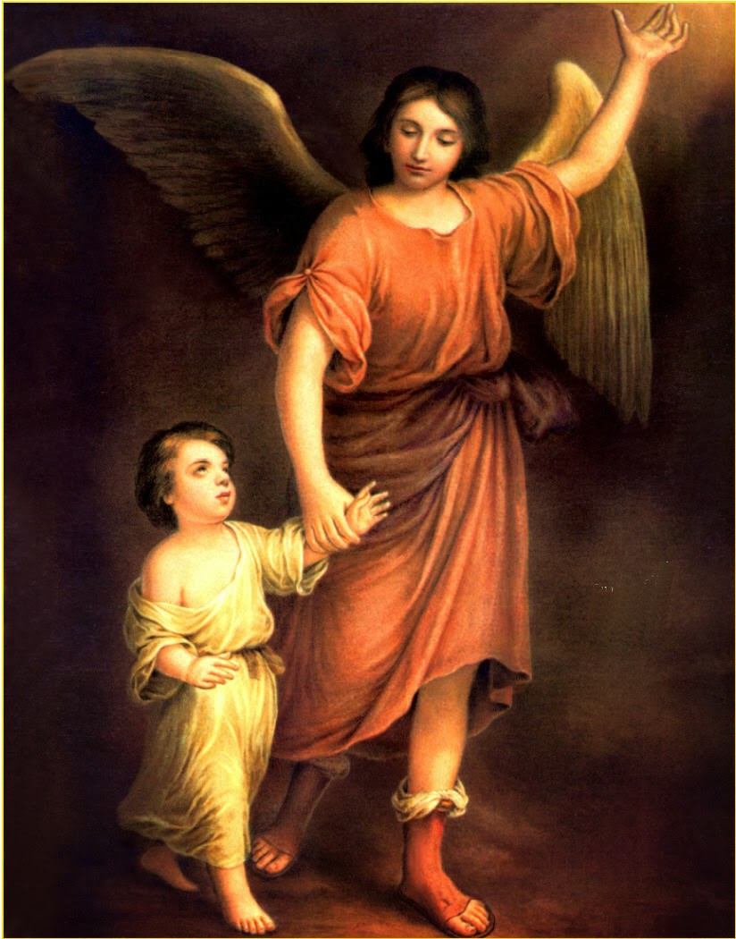
Angel of God
Angel of God, my guardian dear, to whom God's love commits me here, ever this day be at my side, to light and guard, to rule and guide.
Amen.
BDES

Slide 10
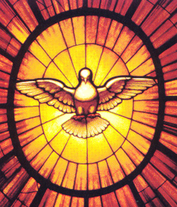
Come, Holy Spirit
Come, Holy Spirit, fill the hearts of your faithful.
And kindle in them the fire of your love.
Send forth your Spirit and they shall be created.
And you will renew the face of the earth.
Let us pray : O God, who by the light of the Holy Spirit, did instruct the hearts of your faithful, grant that by that same Holy Spirit, we may be truly wise, and ever rejoice in your consolation, Through Christ our Lord.
Amen.
BDES

Slide 11
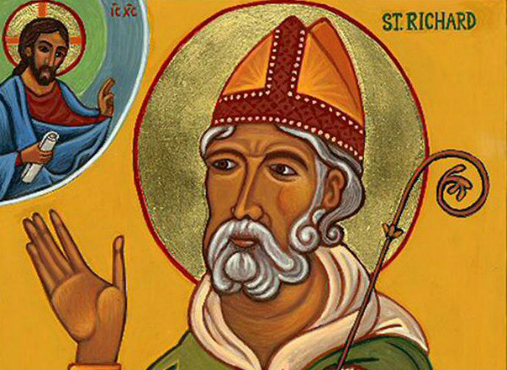
Prayer of St Richard of Chichester
Thanks be to you, my Lord Jesus Christ, for all the benefits you have given me, for all the pains and insults you have borne for me. O most merciful Redeemer, friend and brother, may I know you more clearly, love you more dearly, and follow you more nearly, day by day. Amen.
BDES

Slide 12
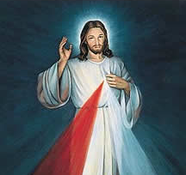
Morning Offering
O Jesus,
through the most pure heart of Mary,
I offer you all my prayers, thoughts,
works and sufferings of this day
for all the intentions
of your most Sacred Heart.
BDES

Slide 13
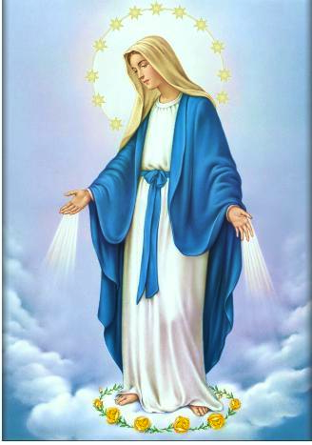
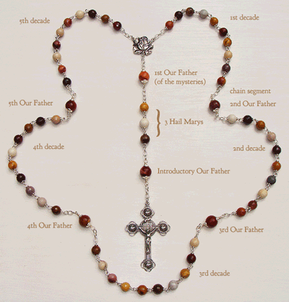
The Rosary
BDES

Slide 14
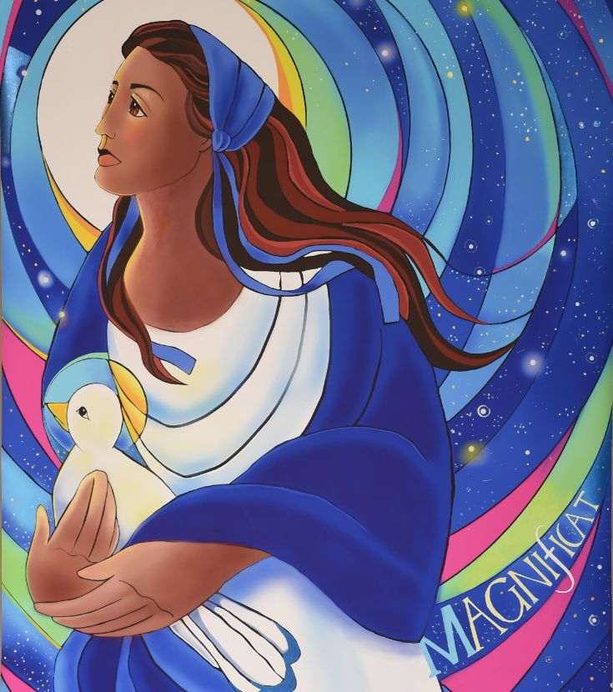
The Magnificat
My soul proclaims the greatness of the Lord, my spirit rejoices in God my Savior, for he has looked with favour on his lowly servant. From this day all generations will call me blessed: the Almighty has done great things for me, and holy is his Name. He has mercy on those who fear him in every generation. He has shown the strength of his arm, he has scattered the proud in their conceit. He has cast down the mighty from their thrones, and has lifted up the lowly. He has filled the hungry with good things, and the rich he has sent away empty.
BDES

Slide 15
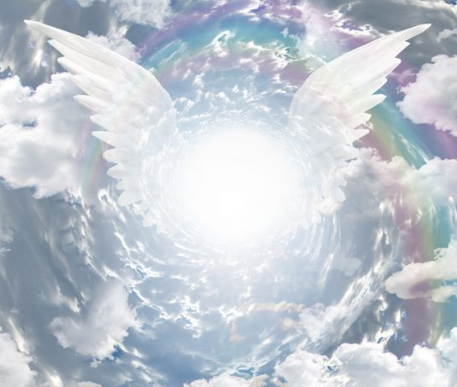
Act of Faith
My God,
I believe in you
and all that
your Church teaches,
because you have said it,
and your Word is true.
BDES

Slide 16
Act of Hope
My God,
I hope in you,
for grace and for glory,
because of your promises,
your mercy
and your power.
BDES

Slide 17
Act of Love
My God,
because you are so good,
I love you
with all my heart,
and for your sake,
I love my neighbour
as myself.
BDES

Slide 18
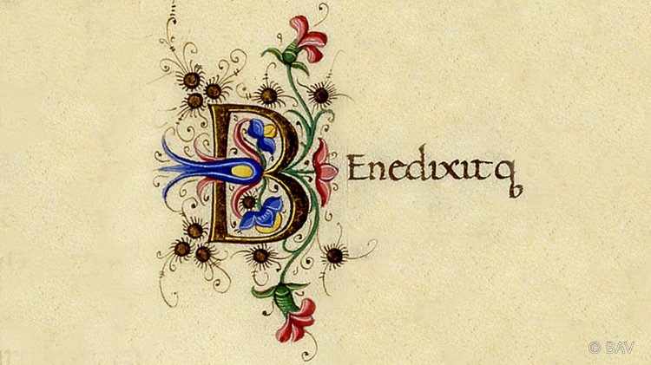
The Benedictus
Blessed be the Lord, the God of Israel; he has come to his people and set them free. He has raised up for us a mighty savior, born of the house of his servant David. Through his holy prophets
he promised of old that he would save us from our enemies, from the hands of all who hate us ….
BDES

Slide 19
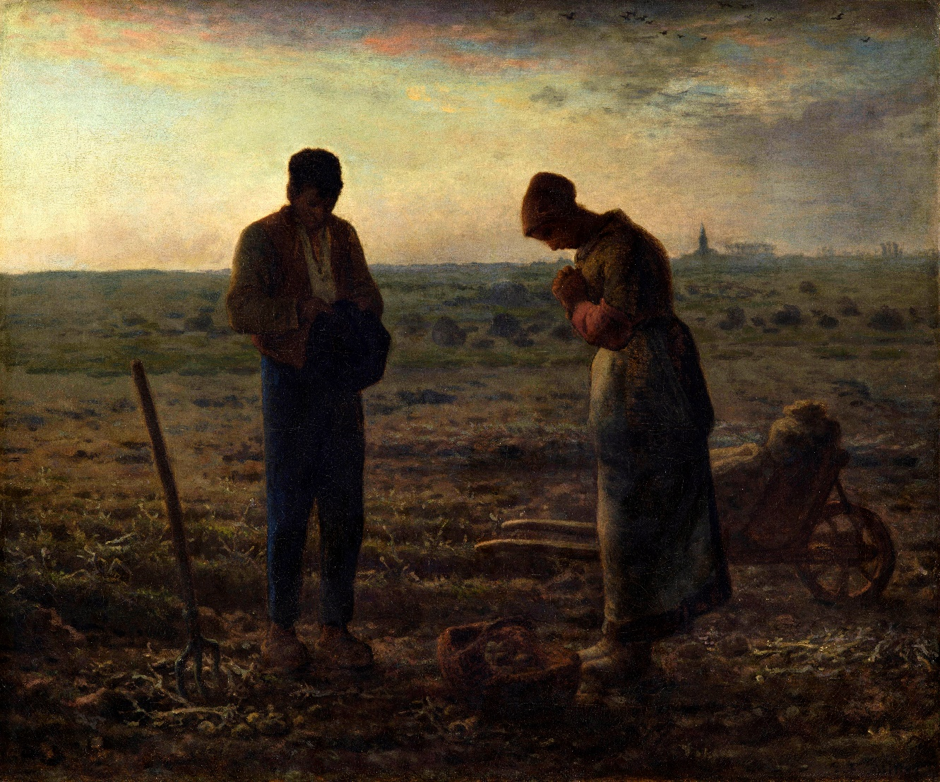
The Angelus
℣. The Angel of the Lord declared unto Mary, ℟. And she conceived of the Holy Spirit.
Hail Mary, full of grace; the LORD is with thee …
℣. Behold the handmaid of the LORD. ℟. Be it done unto me according to thy word.
Hail Mary, full of grace; the LORD is with thee ….:
℣. And the Word was made flesh. ℟. And dwelt among us …
BDES

Slide 20
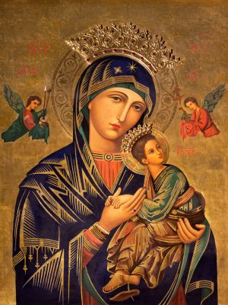
Hail Holy Queen
Hail, holy Queen, Mother of Mercy, Hail our life, our sweetness and our hope. To thee do we cry, Poor banished children of Eve; To thee do we send up our sighs, Mourning and weeping in this valley of tears. Turn then, most gracious advocate, Thine eyes of mercy toward us; And after this our exile, Show unto us the blessed fruit of thy womb, Jesus. O clement, O loving, O sweet Virgin Mary …
BDES

Slide 21
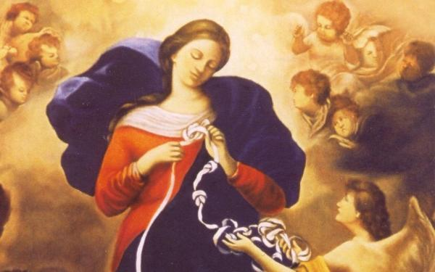
The Memorare
Remember, O most gracious Virgin Mary, that never was it known that anyone who fled to thy protection, implored thy help, or sought thy intercession, was left unaided. Inspired by this confidence I fly unto thee, O Virgin of virgins, my Mother. To thee do I come, before thee I stand, sinful and sorrowful. O Mother of the Word Incarnate, despise not my petitions, but in thy mercy hear and answer me. Amen.
BDES

Slide 22
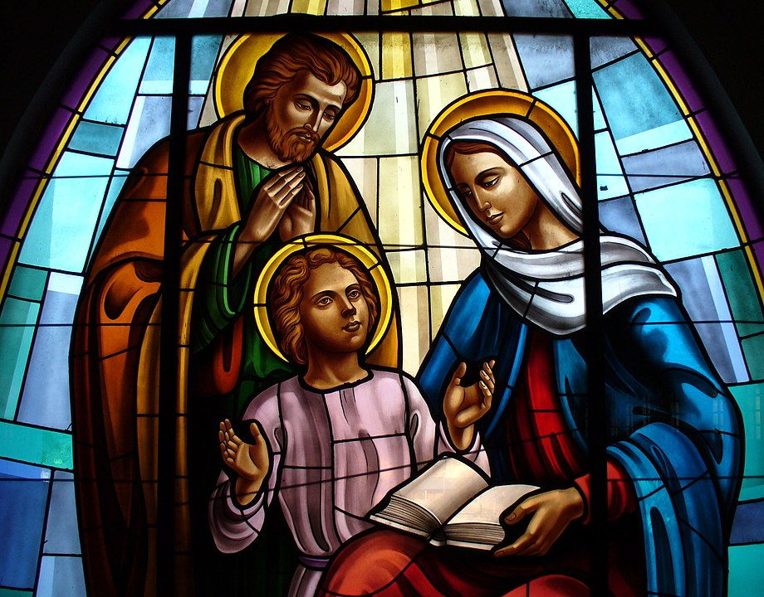
Jesus, Mary and Joseph
Jesus, Mary and Joseph,
I give you my heart and my soul.
Jesus, Mary and Joseph,
assist me in my last agony.
Jesus, Mary and Joseph,
May I breathe forth my soul
in peace with you.
BDES

Slide 23
Eternal Rest
Eternal rest grant unto them,
O Lord,
and let perpetual light
shine upon them.
May they rest in peace.
Amen
BDES

