Slide 1
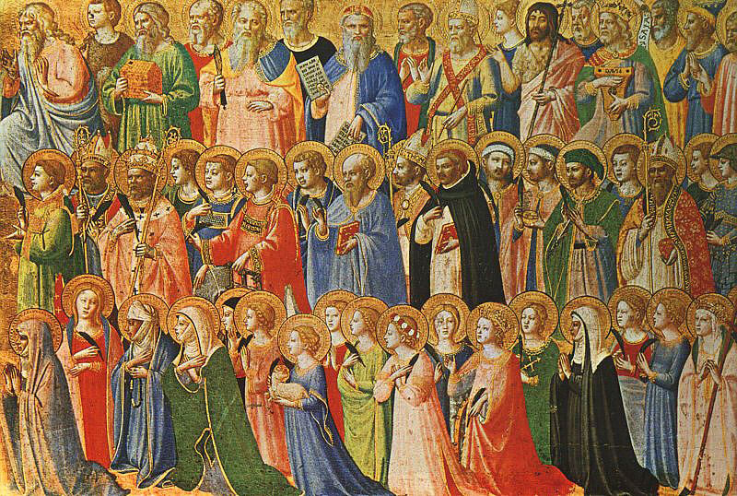
Compilation: Saints
Monday 3rd July 2023
Brentwood Diocese Education Service

Slide 2
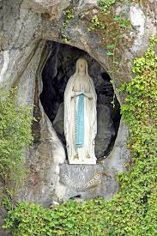
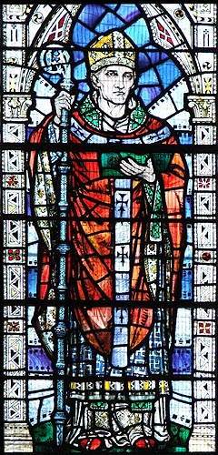
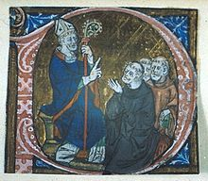
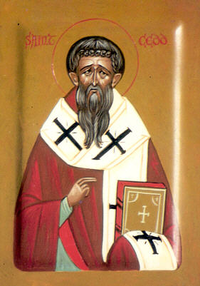
Patron Saints of the Diocese
Our Lady of St Edmund St Erconwald St Cedd
Lourdes of Canterbury

Slide 3
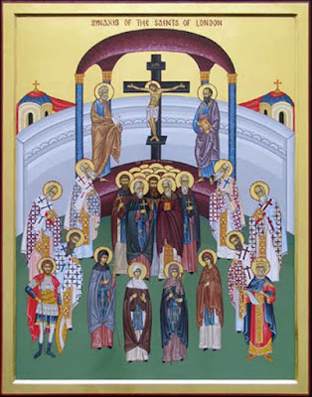
Saint Sebbi of Essex:
29th August
Sebbi was King of Essex from 664 until 694 AD. According to St Bede, he was given to “religious action, almsgiving, and frequent prayer, preferring a private and monastic life to all the wealth and honours of his kingdom.” His brother and joint-king Sighere fell back into pagan worship and took many people with him but Sebbi remained a loyal Christian and re-established the faith. He was buried in St Paul’s but his tomb was lost in the Great Fire of London. He is now commemorated in a plaque in Sir xxx Christopher Wren’s magnificent cathedral.
St Sebbi is amongst the saints of London.
He was buried in Old St Paul’s Cathedral.
BDES

Slide 4
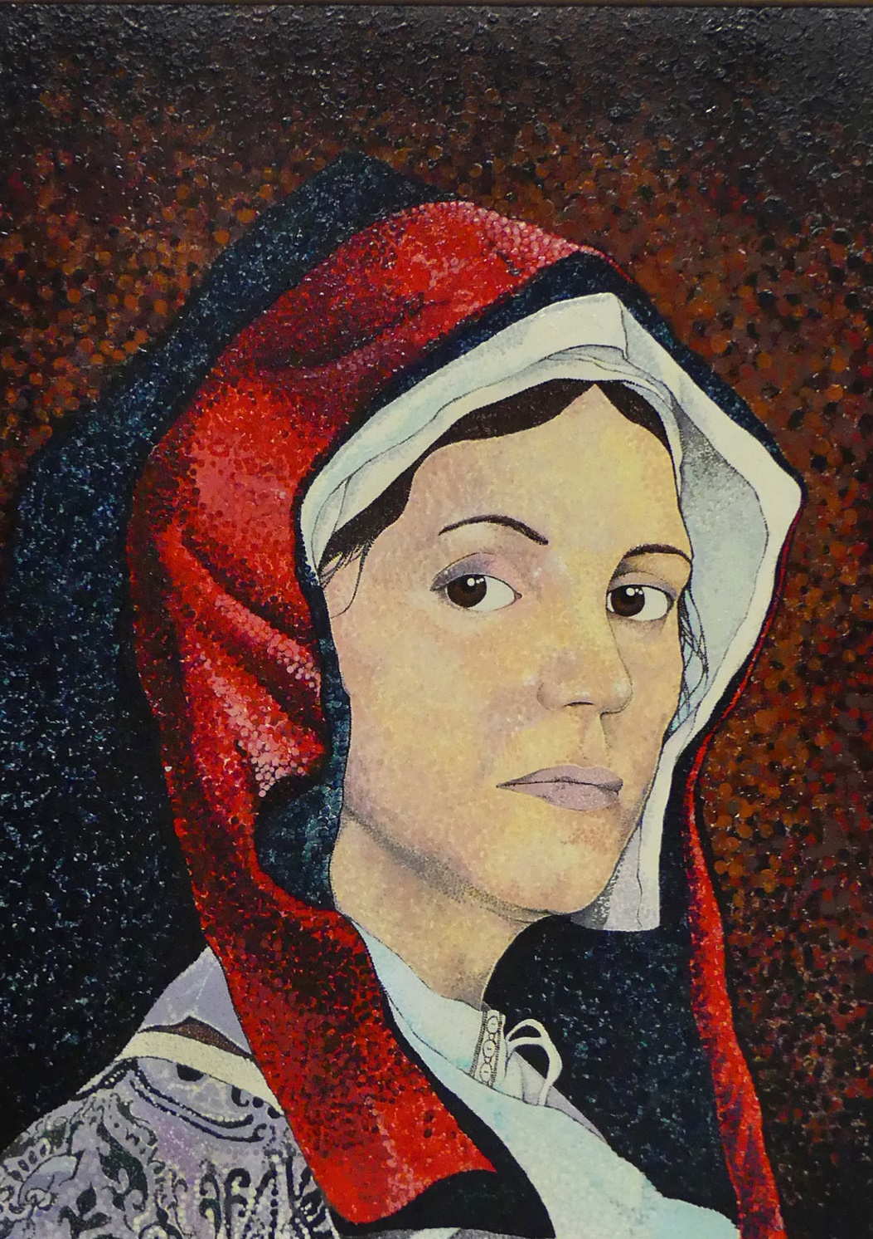
St. Margaret Ward: 30th August
Margaret Ward lived in London in the service of a lady when she learned of the severe maltreatment of Father Richard Watson in the Bridewell Prison. She visited him and she managed to smuggle him a rope with which he escaped. She was a logical suspect and was arrested and tortured, but refused to disclose the priest's whereabouts. She was hanged at Tyburn on 30th August 1588, and declared one of the Forty Martyrs … of England and Wales by Pope Paul VI in 1970.
BDES

Slide 5
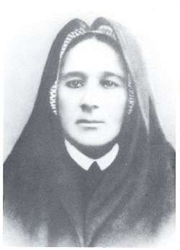
Blessed Eugenia Picco:
7th September
She was born in the district of Milan called Crescenzaga in 1867. Her father was a famous musician and she was left with her grandparents while her parents were away, then her father disappeared and her home life was difficult. She ran away from home at the age of 20 and joined the Congregation of the Little Daughters of the Sacred Hearts of Jesus and Mary. She became their Superior General in 1911 and was a kind mother to all she met. She suffered ill health patiently, dying in 1921. Blessed Eugenia is is remembered as a model of virtue and a wise teacher.
BDES

Slide 6
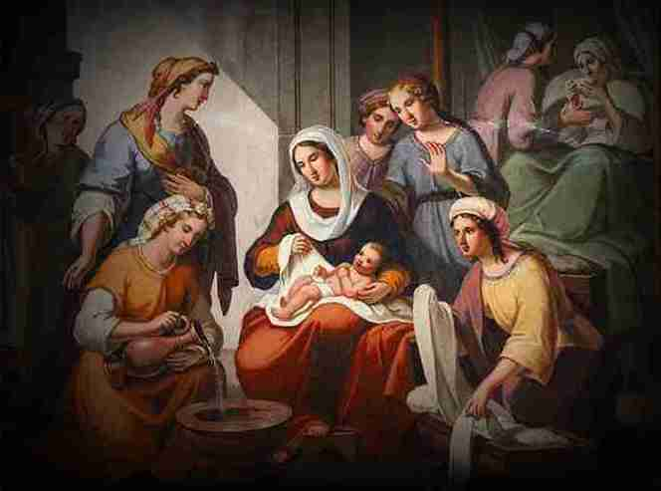
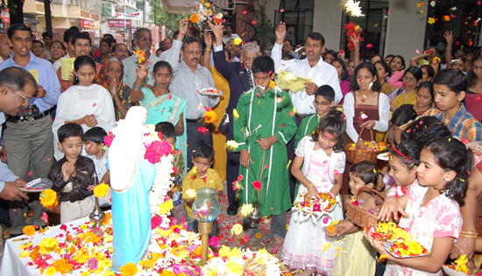
Nativity of the Virgin Mary: 8th September
This feast day celebrates the birth of the Virgin Mary the mother of Jesus.
It is celebrated nine months after the feast of the Immaculate Conception, meaning that Mary did not have the stain of original sin on her soul.
There are celebrations in September in different parts of the world.
In France, this time of year is celebrated as ‘Our Lady of the Grape Harvest’ and in different parts of India there are different customs, including holding festive meals and showering flowers on a statue of Mary.
BDES

Slide 7
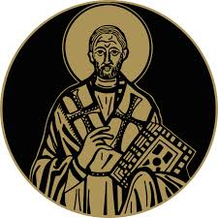
St John Chrysostom:
13th September
St John, who lived 347-407 AD in Antioch, was known as Chrysostomos (“Golden Mouth”) on account of his gift of eloquence. He was a gifted public speaker at the Golden Church of Antioch, interpreting Scripture and preaching compassion for the poor. He became Archbishop of Constantinople
in 397, reformed the clergy and founded several hospitals. He lived a simple life but made political enemies on account of his preaching and was banished. One of his celebrated teachings is that “prayer without almsgiving is unfruitful.”
BDES

Slide 8
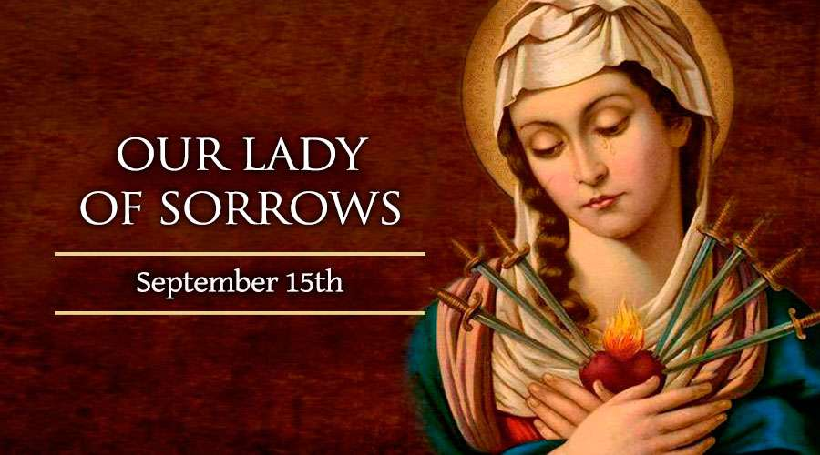
BDES

Slide 9
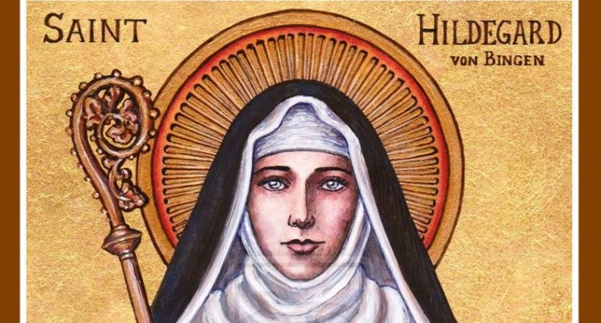
St. Hildegard of Bingen:
17th September
Hildegard was born in 1098 and experienced visions from a young age. She joined a Benedictine convent, of which she became the abbess. She had extraordinary gifts and as well as being remembered as a visionary, she achieved fame as a scholar, a writer, a composer, a philosopher and a mystic. She wrote theological, botanical and medical texts as well as letters, hymns, antiphons, and poems. She is one of the few known composers of the Middle Ages to have written both the music and the words. She wrote the earliest surviving mystery play and invented a language; she is seen as the founder of scientific natural history in Germany. On 7th October 2012, Pope Benedict XVI named her a Doctor of the xxx Church, in recognition of “her holiness of life and the originality of her teaching.”
BDES

Slide 10
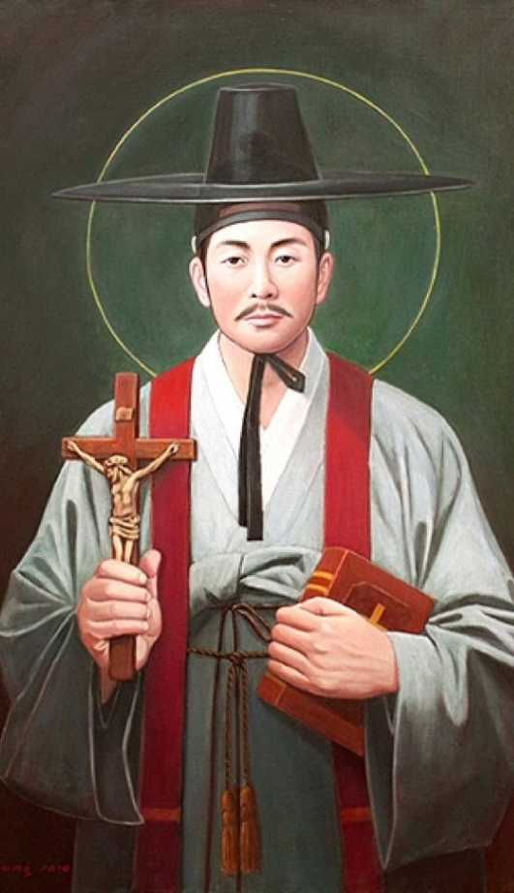
St Andrew Kim Taegon:
20th September
St Andrew Kim Taegon was the first Korean-born Catholic priest and is the patron saint of Korean clergy.
He was baptised at the age 15 and joined the seminary in Macau. He then became a priest and returned to Korea.
Christianity was persecuted in his home country and at the age of 25 he was martyred near Seoul.
He was canonised in 1984 during a visit of Pope John Paul II to Korea and his feast day is celebrated on 20th September.
.
BDES

Slide 11
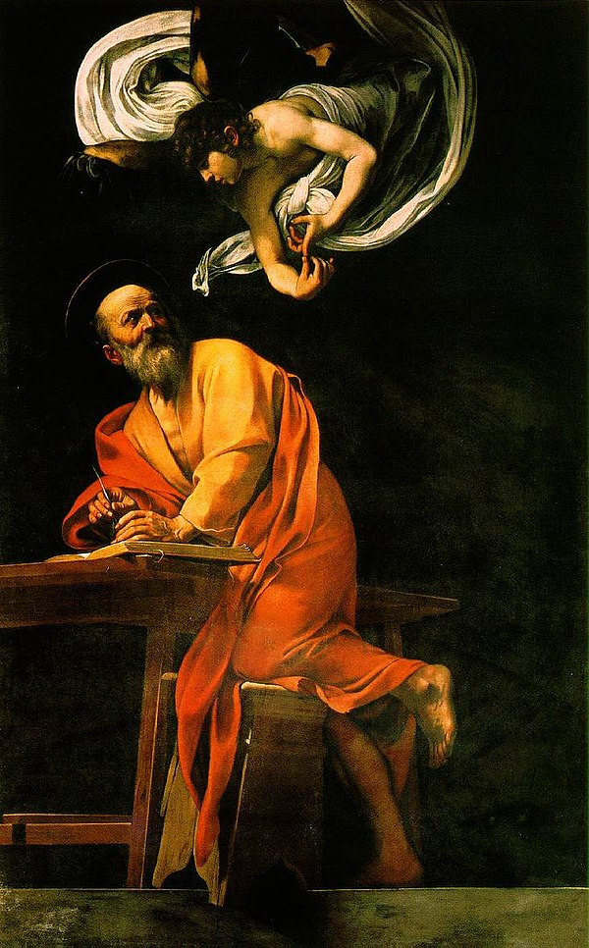
St Matthew: 21st September
St Matthew was one of Jesus’ disciples who witnessed His Ascension into heaven.
Matthew was a tax collector, as such he would have been despised by his fellow Jews as he worked for the Romans. Matthew invited Jesus to dinner, causing the Pharisees and Scribes to criticise Jesus. Jesus’ response, recorded in the Gospel, was that He had not come to call the righteous but to call sinners to repent.
St Matthew is remembered as one of the Four Evangelists.
He died as a martyr and his feast is celebrated on 21st September.
BDES

Slide 12
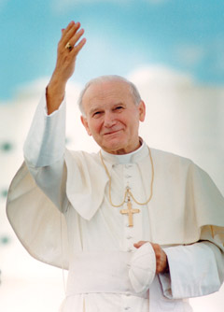
Saint John Paul II: 23rd September
Pope John Paul II was born in Poland as Karol Wojtyla before World War II.
He was a good sportsman, often playing in goal in football and was also involved in the theatre in his younger days.
He was an impressive linguist, using nine of the languages he had learnt when he became Pope.
His decision to become a priest came during the war; he survived having hidden from the German forces who rounded up many of the young men in Krakow.
He was made a Bishop in 1958 and was involved in the Second Vatican Council and in 1964 was made Archbishop of Krakow. In 1978 (the year of the three Popes) he was elected by the College of Cardinals and took the name John Paul II.
He pioneered World Youth Day and was very active in all areas of the Papacy.
He died in 2005 following a period of ill health.
He was beatified by his successor Pope Benedict in 2011 and canonised by
Pope Francis with Emeritus Pope Benedict concelebrating in 2014.
BDES

Slide 13
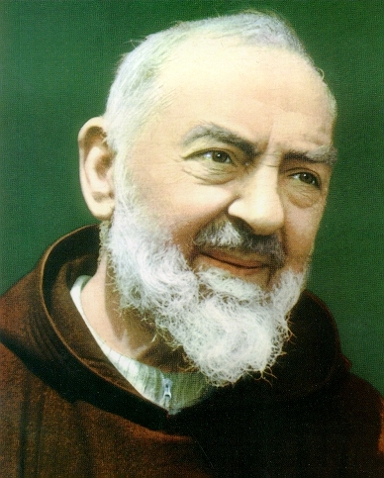
Saint Pius of Pietrelcina (Padre Pio): 23rd September
Francesco Forgione, better known as Padre Pio and also Saint Pius of Pietrelcina was born on 25 May 1887 and died on 23rd September 1968. He was a member of the Italian Franciscan Capuchin order.
Padre Pio became famous for exhibiting stigmata for most of his life, thereby generating much interest and controversy. This means that he experienced bodily marks, pain, and bleeding in locations corresponding to the crucifixion wounds of Jesus.
He was beatified (made Blessed) in 1999. After consideration of Padre Pio's virtues and ability to do good even after his death, including discussion of healings attributed to his intercession, John Paul II declared Padre Pio a saint on 16th June 2002. An estimated 300,000 people attended the canonization ceremony in Rome.
BDES

Slide 14
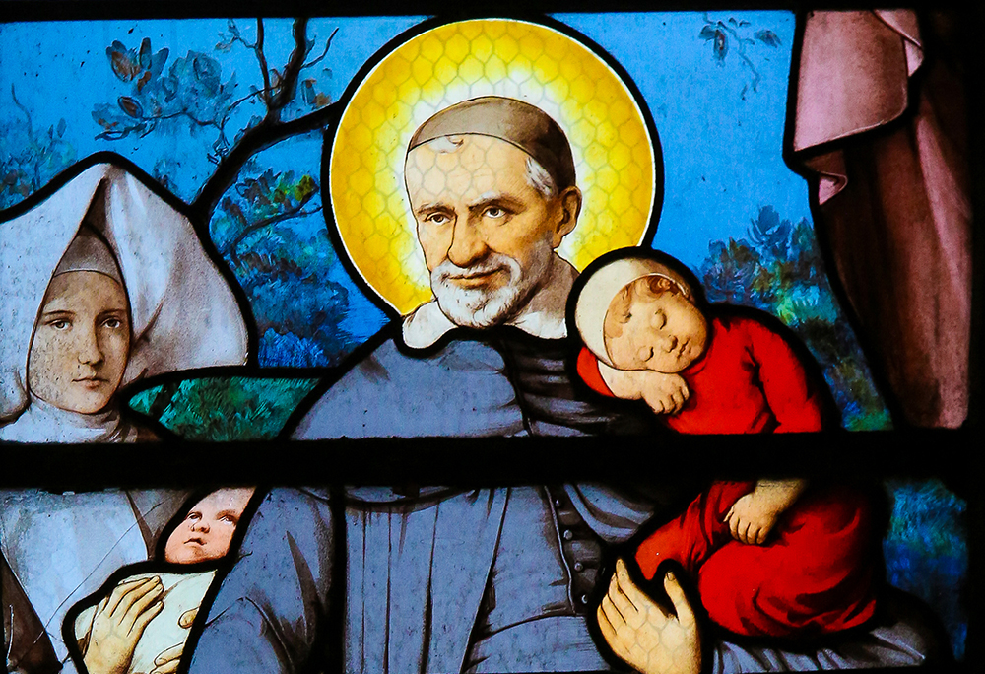
St. Vincent de Paul:
27th September
Vincent was born in Gascony, France in 1581 and was ordained a priest in 1600. He dedicated his life to serving the poor and in 1622 was appointed as chaplain to the galleys, specifically ministering to the galley slaves imprisoned in Paris. He became the superior of a new order known as the Congregation of the Mission, which we now call the Vincentians. Priests of the order take vows of poverty and devote themselves to care for the poor. Vincent conducted retreats for priests to help them develop spiritually, established seminaries to train them and also founded the Daughters of Charity. He died in 1660 and was canonised in 1737.
BDES

Slide 15
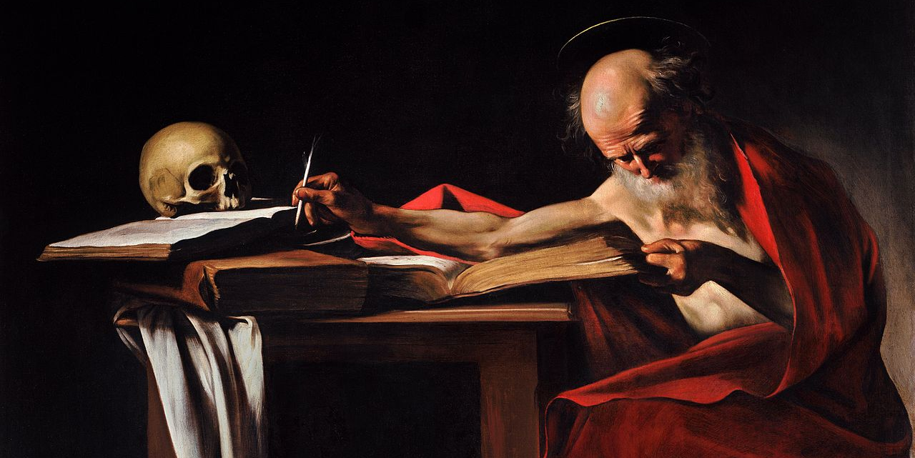
St Jerome translated the Bible from Hebrew and Greek into Latin.
____________________________________
Prayer of St. Jerome:
“O Lord,
you have given us
Your word as a light
to shine upon our path;
help us to meditate
on that word,
and follow its teaching,
that we may find in it
the light that shines
more and more
until the perfect day.”
Amen
St Jerome : 30th September
BDES

Slide 16
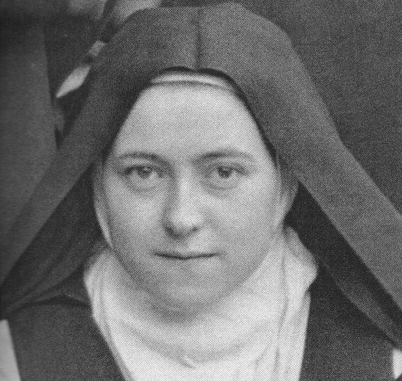
Saint Thérèse of Lisieux:
1st October
St Thérèse (1873-1897) is also known as Saint Thérèse of the Child Jesus and the Holy Face, and is one of the most popular Catholic saints in the history of the Church. In the Diocese of Brentwood , we have no fewer than four schools named after her, in Basildon,
Dagenham, Lexden and Rochford. She died when she was only 24 years old, but left a spiritual legacy of simplicity, practicality and common sense expressed in her “Little Way” :
“I will seek a means of getting to Heaven by a little way – a very short and very straight little way that is wholly new. I mean to try and find a lift by which I may be raised to God, for I am too tiny to climb the xxx steep stairway of perfection. Your arms, then, Jesus, are the lift which will raise me up to Heaven.”
BDES

Slide 17
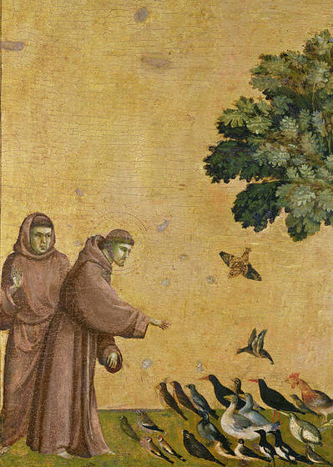
St Francis of Assisi: 4th October
St Francis is one of the most recognised and revered saints. He founded the Order of the Friars Minor (Franciscans) and the Order of St Clare, as well as an order for lay people.
He was born in the late 12th century in Italy of wealthy parents, living a good life, becoming a soldier and going on pilgrimage to Rome. He then chose to live a simple life, having lost interest in his former pastimes, and attracted many followers. The Pope agreed to the group being recognised by the Church. Francis travelled widely, to Egypt where he met the Sultan and to the Holy Land.
He created the first Nativity scene, using living animals. In 1224 Francis received the stigmata, dying on 3rd October 1226. He believed nature is the ‘mirror of God’ and was declared the patron saint xxxx of ecology in 1979.
BDES

Slide 18
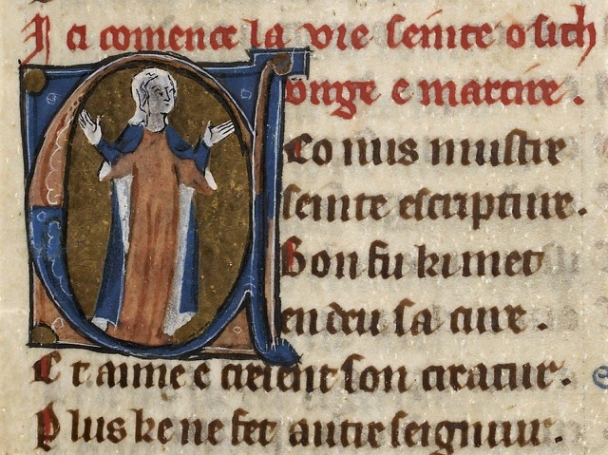
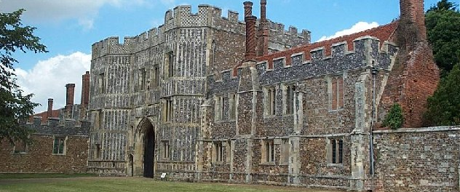
St Osyth : 7th October
St Osyth or Osgyth was an English saint of the 8th century from the Kingdom of Essex. She was from a noble family and became the abbess of a priory near the manor Chich. She probably died about 700 AD, martyred by beheading by some raiding pirates for refusing to renounce her faith.
In the 12th Century a priory of Augustinian Canons was built on the site of Osyth’s monastery and named after her. The village of Chich also took on her name. It was later dissolved during the Dissolution of the Monasteries by Henry VIII. The buildings were sold to the Darcy family in the 16th century and part of the gatehouse remains visible today.
BDES

Slide 19
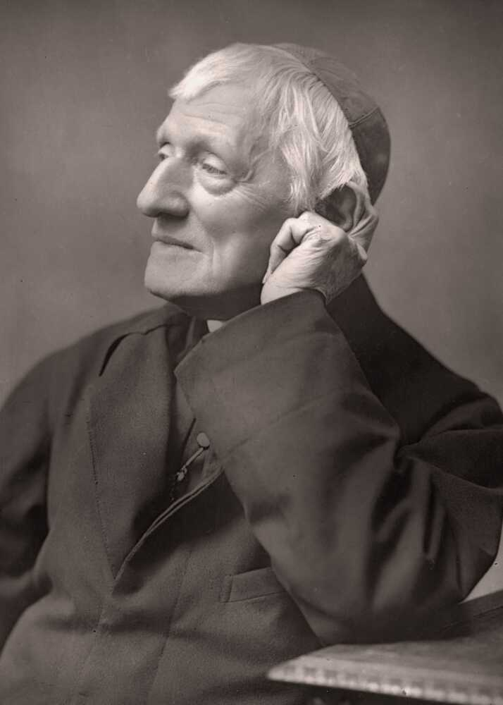
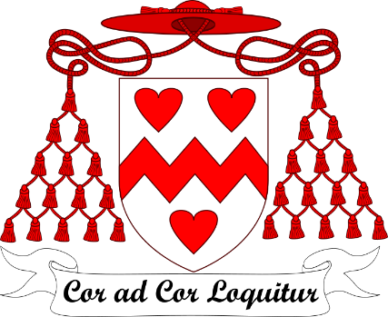
St John Henry Newman: 9th October
St John Henry Newman chose “Heart speaks unto Heart” as the motto to go on his coat of arms when he became a Cardinal in 1879. Inspired by these words spoken by St. Francis de Sales, Newman calls us to hear God speaking to our hearts and to listen for our mission from God.
BDES

Slide 20
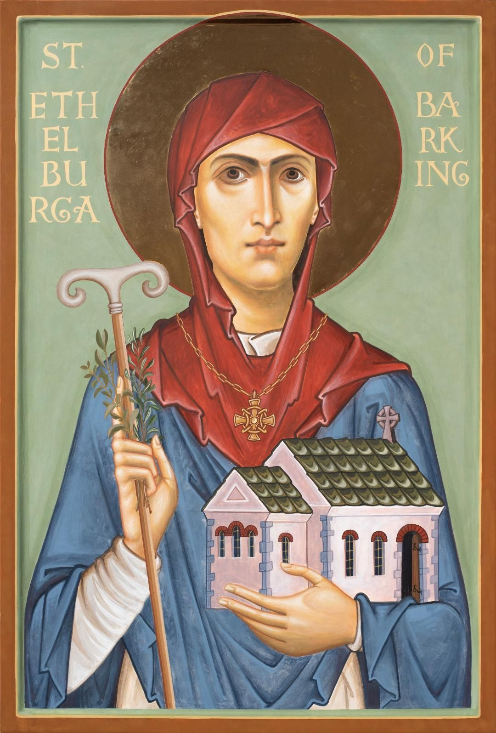
St. Ethelburga of Barking:
11th October
A local saint of our diocese, St Ethelburga (Aethelburh) was the sister of St Erconwald, a 7th-century bishop of London, and abbess of a monastery for both men and women in Barking. The Anglo-Saxon historian Saint Bede describes her as “upright in life and constantly planning for the needs of her community.”
BDES

Slide 21
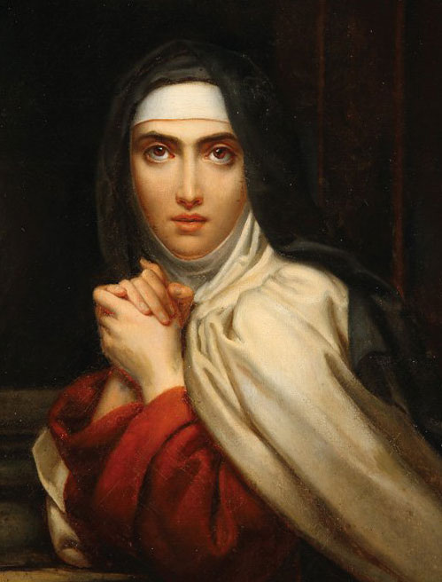
St Teresa of Ávila:
15th October
St Teresa founded the order of Discalced Carmelites. She was a mystic, a religious reformer, an author, a theologian of the contemplative life and prayer, and has been such an influential thinker that she has been declared a Doctor of the Church. Her famous prayer is a source of comfort and calm :
Let nothing disturb you. Let nothing frighten you. All things pass away. God never changes. Patience obtains all things.
Whoever has God lacks nothing. God alone suffices.
BDES

Slide 22
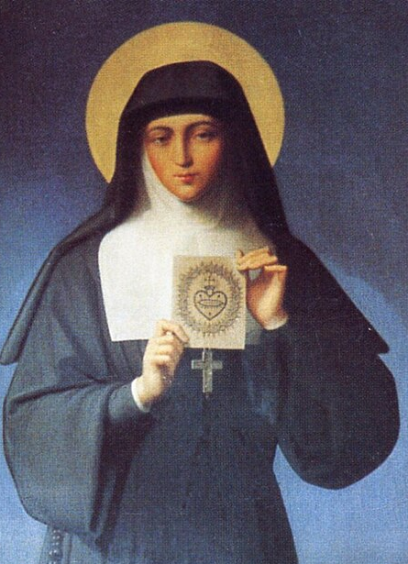
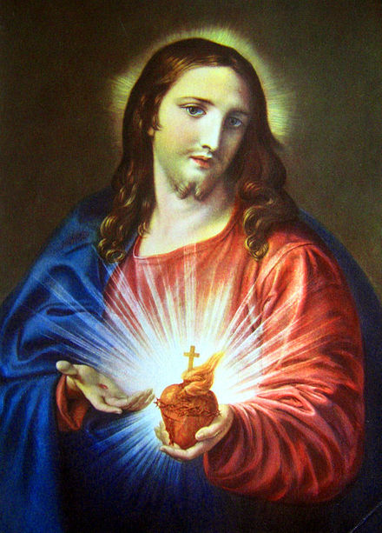
St Margaret Mary Alacoque: 17th October
.
Margaret Mary Alacoque, VHM was born on 22nd July 1647 and died on 17th October 1690. She was a French nun in the Visitation order. She had been ill as a child and during this time offered to become a religious. As she grew older her family wanted her to marry but she was visited by a vision of Christ and became a nun at the age of 24.
In the convent she saw a number of visions of Christ and as a result she promoted devotion to the Sacred Heart of Jesus in its modern form.
BDES

Slide 23
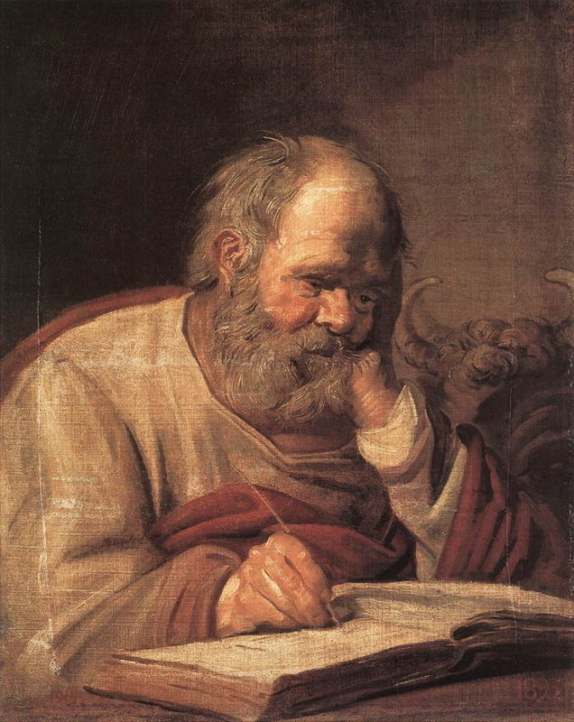
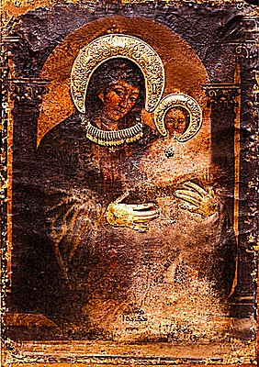
St Luke: 18th October
One of the four Evangelists, the Gospel writers, Saint Luke was a follower of St Paul and by tradition a physician.
He is thought to have written both the Gospel that bears his name and the Acts of the Apostles, found in the New Testament.
As well as being the patron saint of doctors he is also the patron saint of artists as according to an ancient story he was the painter of an icon of the Madonna and Christ Child.
BDES

Slide 24
BDES

Slide 25
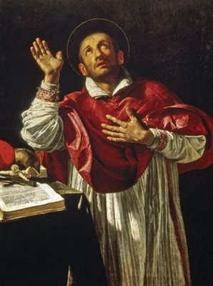
St. Charles Borromeo:
4th November
Carlo Borromeo (1538–1584) was Archbishop of Milan and a cardinal of the Catholic Church. He was responsible for important Church reforms, including the founding of seminaries for the education of priests. He was a great help to English Catholics in Italy who had fled persecution at home under Elizabeth I, and carried on his person a picture of the martyred English bishop John Fisher.
BDES

Slide 26
St. Martin of Tours:
8th November
Martin of Tours was a former soldier in the Roman army and Bishop of Tours in France. He had become a monk and was made Bishop where he challenged the pagan traditions. There is a story about him giving half his cloak to a beggar; Martin’s cloak was then miraculously became whole again. He is the patron saint of beggars and many other groups as well as being a patron saint of France.
BDES

Slide 27
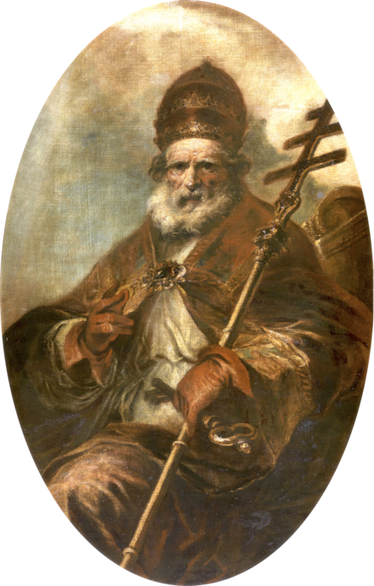
Saint Leo the Great: 10th November
Leo the Great was Pope in the 5th Century.
His papacy has been described by Pope Benedict XVI as "undoubtedly one of the most important in the Church's history.“
Leo persuaded Attila the Hun to turn back from his invasion of Italy, wrote important theological documents as well as developing the idea of Papal authority. It was during his term of office that the word Pope was used to solely mean the Bishop of Rome.
His writings and sermons centred on theological questions around the person of Christ (Christology).
He died on 10th November 461 and was buried in the old Basilica of St Peter in Rome.
He is one of only two Popes to be recognised as a Doctor of the Church.
BDES

Slide 28
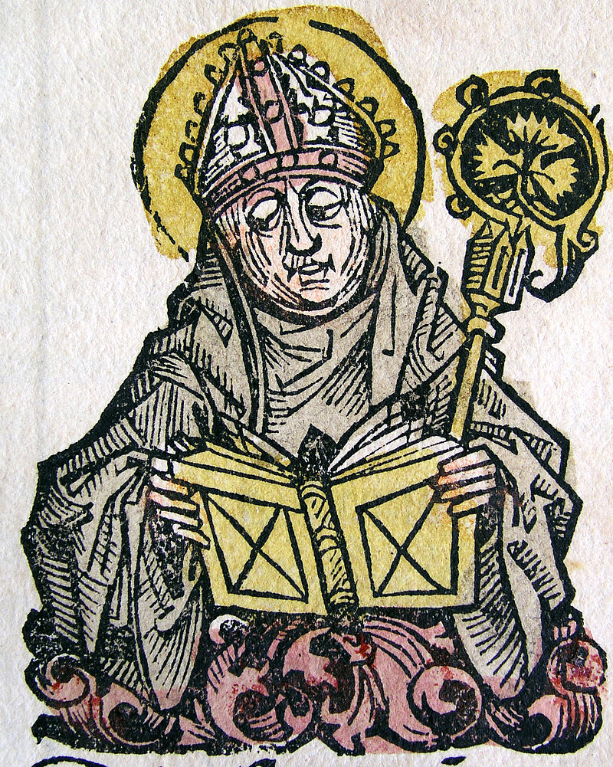
St. Edmund of Canterbury:
16th November
St Edmund, along with Our Lady of Lourdes, St Erconwald and St Cedd, is one of the patrons of the Diocese of Brentwood. He was a renowned scholar of the universities of Paris and Oxford and was appointed as Archbishop of Canterbury in 1233. St Edmund’s Hall, one
of the colleges of the University of Oxford, is named after him.
BDES

Slide 29
St Hilda of Whitby:
17th November
St Hilda (c. 614 – 680 AD) was the founding abbess of the double monastery (i.e. a monastery for men and women) at Whitby in Yorkshire. She was so highly respected that her monastery was chosen as the venue for the important Synod of Whitby in the year 664, where the Christians of Northumbria agreed to accept the dating of Easter according to the Church of Rome. The historian St Bede wrote of her : “All who knew her called her mother because of her xxxxx outstanding devotion and grace.”
BDES

Slide 30
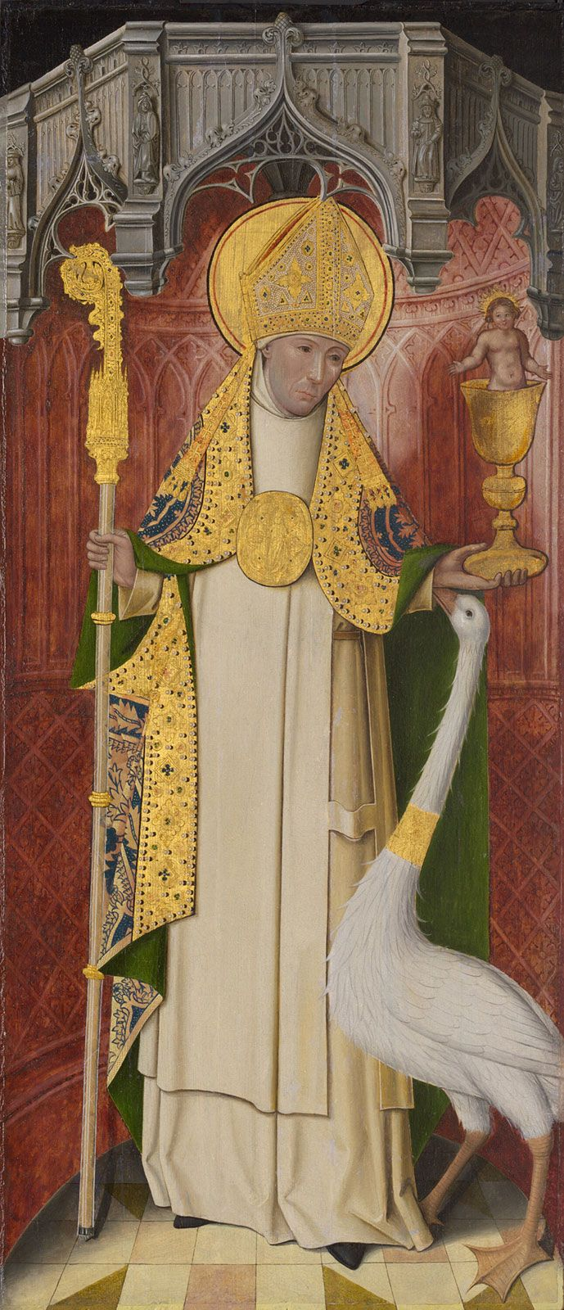
St Hugh of Lincoln: 17th November
Like most of the great churchmen who came to England from abroad in the Middle Ages, Hugh of Avalon in Burgundy was a mighty builder. He rebuilt Lincoln cathedral, ruined by the great earthquake of 1185 and is responsible for the four bays of the choir, one of the finest examples of the Early English pointed style. He also began the great hall of the bishop’s palace. St. Hugh’s emblem is a white swan, in reference to the beautiful story of the swan of Stowe which contracted a deep and lasting friendship for the saint, even guarding him while he slept.
BDES

Slide 31
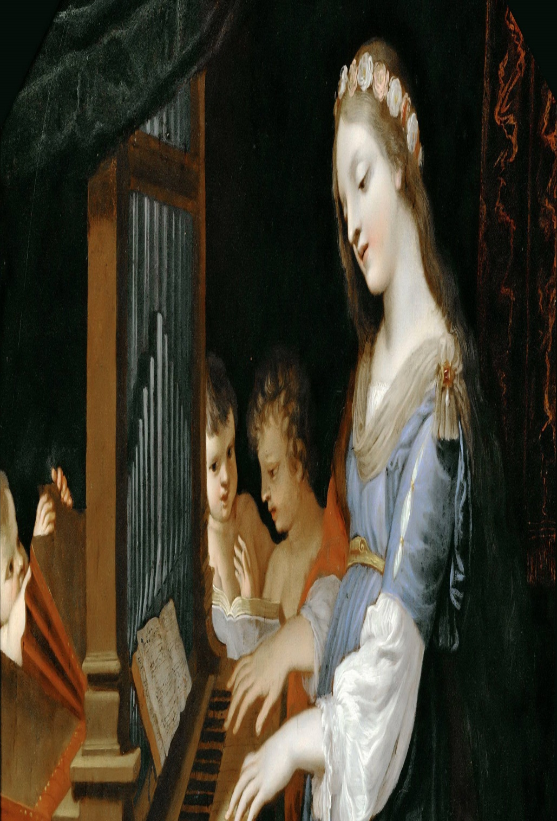
St. Cecilia:
22nd November
St Cecilia is the patron saint of musicians with her feast day often being celebrated with concerts and musical events. She symbolizes the central role of music in the Liturgy of the Church.
She lived in Roman times and was executed for her beliefs. At her wedding, she was reputed to have sung her heart to God and was responsible for the conversion of her husband, who was baptized by Pope Urban I. She did good works and distributed her goods to the poor.
Her death followed that of her husband and brother-in -law, and she requested that after her death her home be converted into a church.
BDES

Slide 32
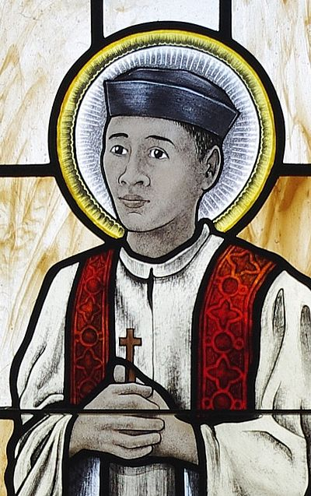
Saint Andrew Dung-Lac:
24th November
His feast day is on 24th November, a day which commemorates all the Vietnamese martyrs of the seventeenth, eighteenth and nineteenth centuries. Andrew was born in Vietnam in 1795 and became a priest in 1823. To avoid persecution he changed his name, but was still captured and executed.
He was canonised in 1988 by Pope John Paul II.
BDES

Slide 33
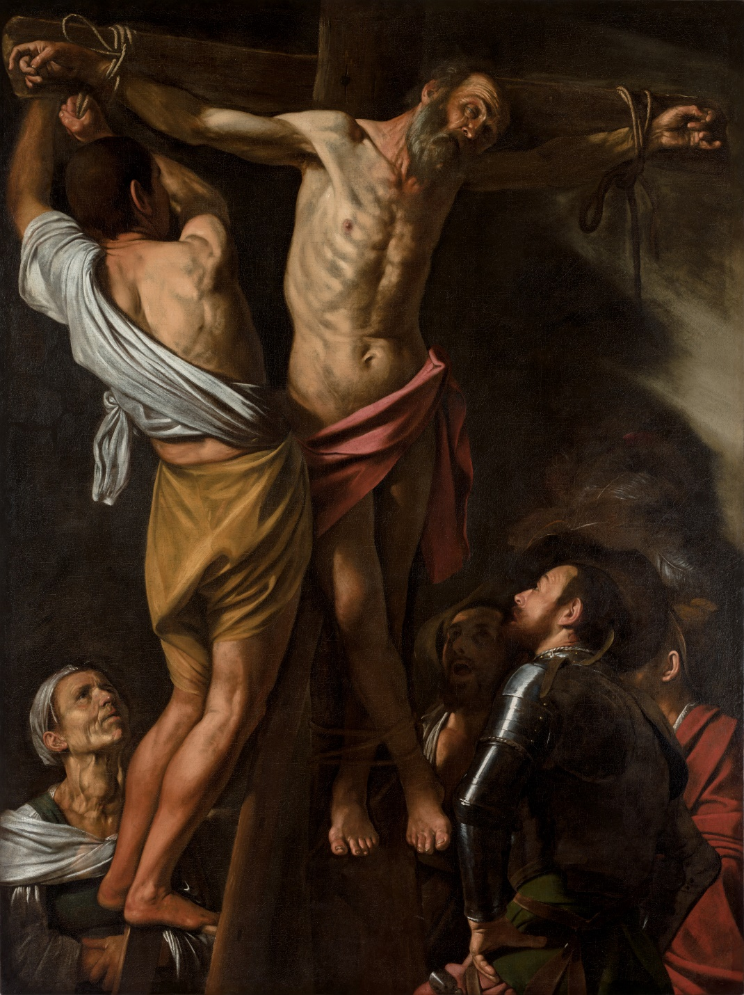
St Andrew’s Day: 30th November
A saint who had that “Get up and go” attitude. An ordinary fisherman, yet he was drawn to become a disciple of John the Baptist and then of Jesus. The Greek Church calls him Protokletos, the “First-Called”. Andrew became an apostle, a missionary and a martyr. He is the patron saint of Scotland and the instrument of his martyrdom, an X-shaped cross, is remembered in the Scottish saltire which is part of the Union Flag.
BDES
Detail of “The Crucifixion of St Andrew” by Caravaggio

Slide 34
Blessed John Beche:
1st December
Blessed John Beche is a saint and martyr of the diocese of Brentwood, the last abbot of Colchester Abbey. He opposed Henry VIII’s Act of Supremacy and claim to be supreme head of the Church in England, and denied the right of the king’s commissioners to confiscate his abbey. He was charged with, and found guilty of treason and was hanged, drawn and quartered at Greenstead on 1st December 1539. His pectoral cross was rescued and is kept at Buckfast Abbey in Devon. He was beatified in 1895.
BDES

Slide 35
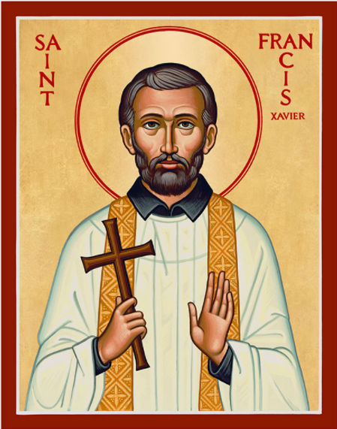
St. Francis Xavier:
3rd December
St Francis Xavier was a companion of Ignatius of Loyola and in 1534 one of the first seven Jesuits to take vows of poverty and chastity. He led a mission into Asia, evangelised in India, and was the first Christian missionary to enter Japan. He learned the local languages but faced more opposition than he had in India. Francis planned to extend his missionary preaching to China when he died on the island of Shangchuan on 3rd December 1552, aged 46. He was beatified by Pope Paul V in 1619 and canonised by Pope Gregory XV in 1622.
BDES

Slide 36
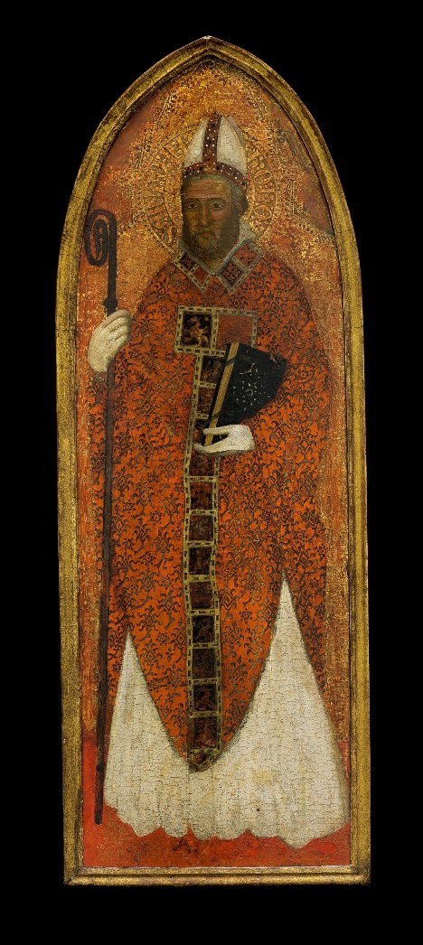
St. Nicholas: 6th December
St Nicholas was a 4th century Bishop who is the patron saint of many groups including students.
There were many miracles granted through his intervention. Due to the story of him calming a storm he is also the patron saint of seafarers, and there are many churches dedicated to him in seaports around the world.
It is difficult to find historical records but the story of him providing gifts of money, in secret, to a poor family appears in many pictures across Europe. He is seen as a great gift giver.
BDES

Slide 37
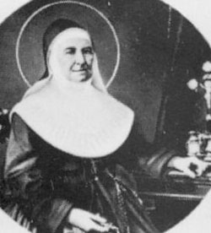
ST MARIA GUISEPPE ROSELLO:
7th December
She was a saint who believed in doing practical things to prepare a way for the Lord. At the age of 26 in 1837, she and three companions, founded a the Daughters of Our Lady of Mercy.
The congregation was devoted to charitable works, hospitals, and educating poor young women. In 1840, Maria Giuseppe, was made superior and put in charge. By the time she died on December 7, 1888, she had set up sixty-eight foundations. She was canonized in 1949.
BDES

Slide 38
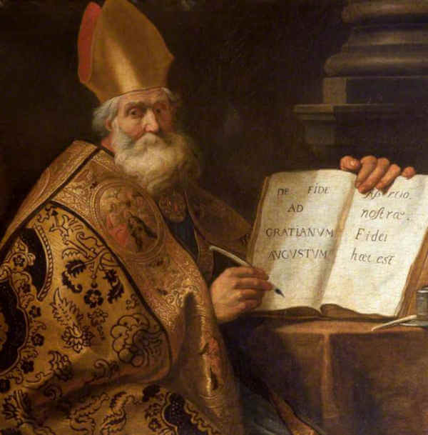
Saint Ambrose:
7th December
St Ambrose was a 4th-century Bishop of Milan.
He was a theologian who also produced hymns and was famous as a preacher.
He is considered to be one of the four doctors of the Church as a result of his works.
He was very concerned about the need of the rich to look after the poor.
Due to an event in his childhood, when a legend has it that a swarm of bees landed on his face whilst he lay in his cradle, he is the patron saint of beekeepers, as well as of the patron of Milan.
His feast day is celebrated on 7th December.
BDES

Slide 39
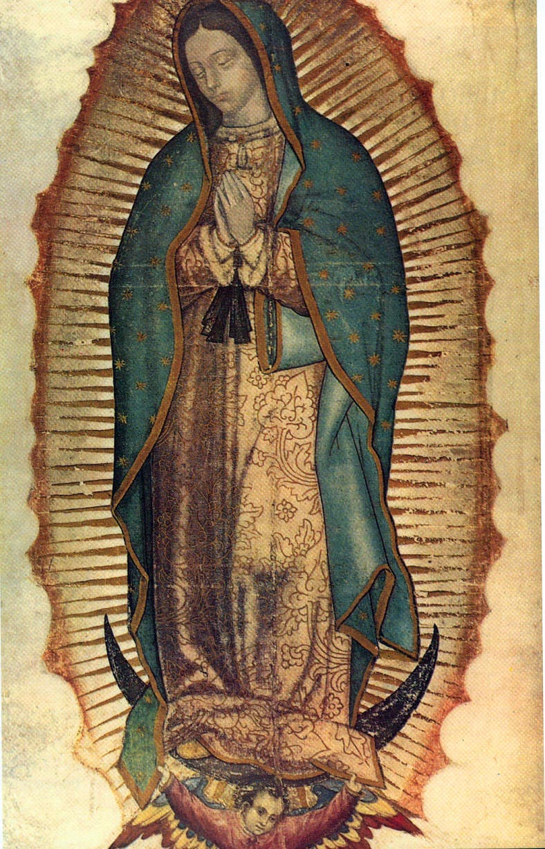
Our Lady of Guadalupe:
12th December
12th December is the Feast of Our Lady of Guadalupe. The day commemorates her apparition to Saint Juan Diego in the hills of Tepeyac in 1531. She asked him to go to the bishop and tell him that the Ever Virgin Mary, Mother of God, sent him to ask for a church to be built on top of the Tepayachill. Our Lady of Guadalupe is the patron saint of the Americas. The bishops of the United States affirm that “Mary embraces God’s will and freely chooses to cooperate with God’s grace, thereby fulfilling a crucial role in xxx God’s plan of salvation.”
BDES

Slide 40
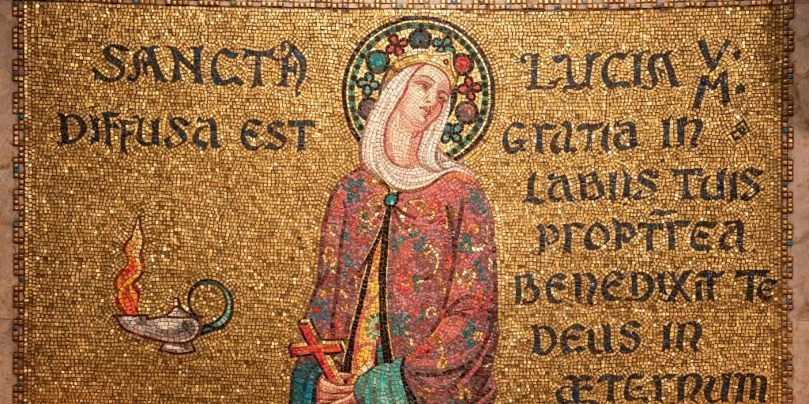
St. Lucy:
13th December
Born in Sicily, St. Lucy converted to Christianity after her blind mother recovered her eyesight. She was martyred at a young age under the persecution of the Emperor Diocletian. The exact reason is uncertain, but tradition holds that a spurned suitor reported her to the governor, who had her killed for her faith. Another tradition holds that, as part of her torture, she was blinded, but her eyesight was miraculously restored. For this reason, she is the patron saint for eyesight. Her feast day marks the beginning of the Christmas season in Scandinavian countries.
BDES

Slide 41
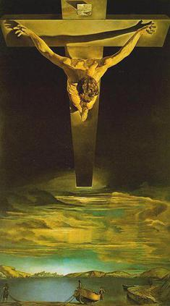
St John of the Cross:
14th December
You might well have seen a print of the popular painting of Christ of St John of the Cross by Salvador Dalí, and wondered at the unusual perspective. St John (1542-1591) sketched a vision he received of Christ on the Cross as though from above, from a heavenly perspective.
BDES
Detail of “Christ of St John of the Cross” by Salvador Dalí

Slide 42
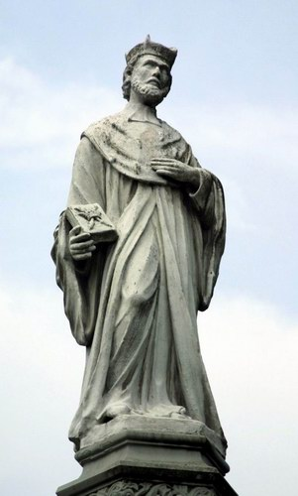
Saint John Kanty: 23rd December
John was from the country. After brilliant studies he became a professor of theology at the university of Kraków, Poland and was ordained a priest. He was then unjustly accused and sent away in disgrace to be a parish priest at Olkusz.
An extremely humble man, he did his best and in the end he won his people’s hearts. After some time he returned to Kraków and taught Scripture for the remainder of his life.
John was a serious man, and humble, but known to all the poor of Kraków for his kindness. His goods and his money were always at their disposal, and time and again they took advantage of him. He kept only the money and clothes absolutely needed to support himself. He slept little, ate sparingly, and took no meat.
His feast day is celebrated on 23rd December.
BDES

Slide 43
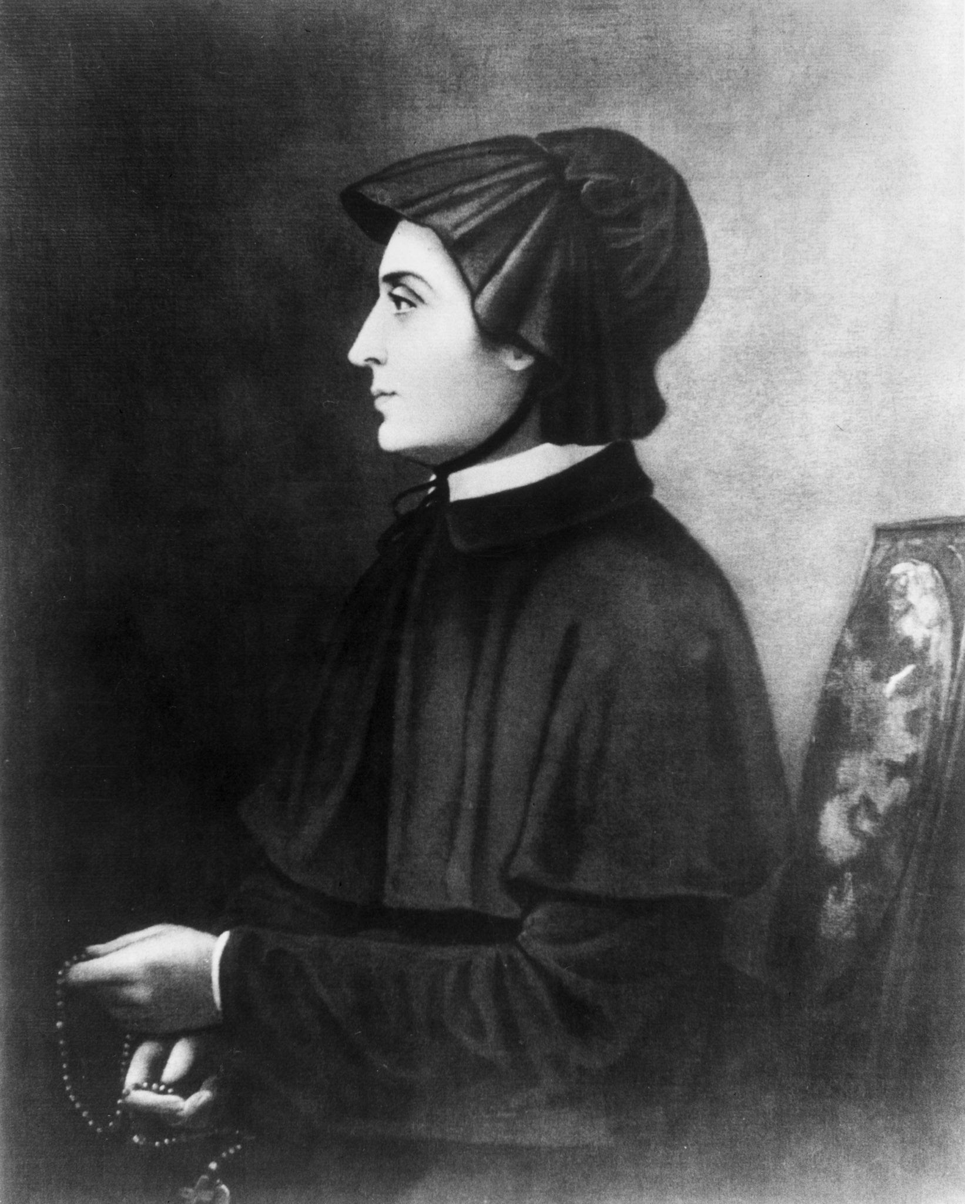
St Elizabeth Ann Seton:
4th January
She was the first person born in the Americas to be made a saint.
She wasn’t born a Catholic but, following her conversion to Catholicism on a trip to Rome, she founded a religious congregation which followed the rules of the Sisters of Charity. Following the death of her husband this became her new life’s new work.
She passed on the joy of her new work : the congregation specialised in running schools for the education of young girls. One of her own XXXXXX daughters was inspired to become a nun.
BDES

Slide 44
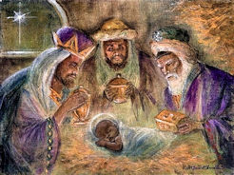
Epiphany : 6th January
The feast of the Epiphany is celebrated on 6th January and marks the end of the twelve days of Christmas.
It celebrates the revelation that Jesus Christ was the Son of God, focussing on the fact that this was revealed to the Three Wise Men.
The gifts they brought of Gold, Frankincense and Myrrh were deeply symbolic. Gold was the sign of kingship, showing Jesus reigns forever, Frankincense was used in worship showing Jesus was God and Myrrh was a herb used to anoint the dead which foreshadowed Jesus’ death and resurrection.
In many cultures Epiphany is celebrated with gift giving and other ceremonies.
BDES

Slide 45
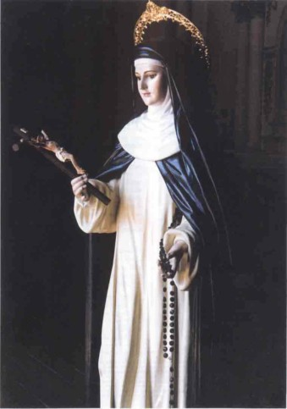
Blessed Ana of the Angels Monteagudo:
10th January
Blessed Ana of the Angels Monteagudo was a Peruvian Dominican Nun who was born in 1602 and died in 1686.
In her childhood she was taught by the nuns and decided to become one following a vision she had of Saint Catherine of Siena showing her in the Dominican habit.
Her parents tried to dissuade her from this but she continued to pursue that path until she became a member of the order of Dominican Nuns.
She became noted for her holiness and held leadership positions because of her wisdom and the esteem that others had for her.
When Pope John Paul II made an apostolic trip to Peru in 1985 he beatified Blessed Ana of the Angels Monteagudo.
BDES

Slide 46
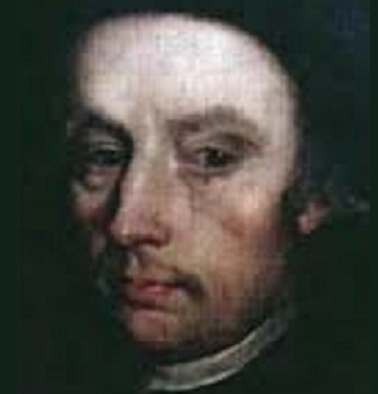
Blessed William Carter:
11th January
William was a printer and bookseller who was arrested several times during the reign of Queen Elizabeth I for printing Catholic pamphlets and failing to attend Anglican services. On the final occasion, in 1581, he was accused of treason because of a publication.
During his 18 months imprisoned in the Tower of London, his wife died. He was tortured on the rack in an attempt to gain the names of further Catholic sympathisers. At his trial, while the jurors deliberated for only 15 minutes, he made his final confession to the priest who was on trial with him. William was hanged, drawn and quartered on 11th January 1584.
BDES

Slide 47
St. Aelred of Rievaulx:
12th January
Aelred (1109 – 1167) was born in Hexham and eventually became abbot of the Cistercian abbey of Rievaulx, the imposing ruins of which can still be visited in North Yorkshire. He is the patron saint of friendship. In one of his many writings, the treatise On Spiritual Friendship, he wrote that “God is friendship … he who lives in friendship, lives in God, and God in him” - in this he consciously echoes John 4 : 16, where Jesus says “God is love. Whoever lives in love, lives in God, and God in them.” Aelred viewed Christ as the source of spiritual friendship. Today is a good day to celebrate friendship!
BDES

Slide 48
St Margaret of Hungary:
18th January
From a young age, St. Margaret was called by God to serve in the religious life. Though she was born a princess, she refused to marry; as a pretty child who grew into a beautiful woman, she sought to counter the temptation to vanity by neglecting her appearance and concentrating on the poor.
She was born noble but she took on the most lowly tasks in the convent. She was considered a Saint even while she lived, and after her death at the young age of twenty-eight, many miracles were attributed to her intercession.
BDES

Slide 49
St. Vincenza Mary Lopez y Vicuna
St Vincentia Maria Lopez y Vicuna was the founder of the Daughters of Mary Immaculate, a religious order dedicated to ministering to the needs of young women in domestic employment. She was a social activist on behalf of women workers during the trying times of the Industrial Revolution, founding homes, hostels, technical schools and canteens.
Of her work, she said : “I count myself happier in the service of these my sisters than the great ones of this world in the service of their lords and kings.”
Her work spread throughout Spain, across Europe and in South America.
Never in perfect health, she died at the age of only 43 on 26th December 1896 in Madrid and was canonized by Pope Paul VI in 1975.
18th January
BDES

Slide 50
St Fabian: 20th January
St Fabian was a Pope and martyr who lived in the 3rd Century.
He was killed by the Roman Emperor Decius in an attempt to destroy the Church. His body was taken in procession to be buried in the catacombs below Rome in 250 AD. It was then moved to the church of St Sebastian by Pope Clement XI in the 18th Century.
Fabian had not sought to become Pope, he had not wanted high office but was elected Pope because of a miraculous sign. A dove descended on him showing that he was the choice of the Holy Spirit.
Becoming Pope meant that he was likely to be threatened and ultimately he died for his beliefs. He would not give up or renounce his faith and had lived a pure and holy life. He died on 20th January 250 AD.
BDES

Slide 51
St. Francis de Sales:
24th January
Francis de Sales (1567–1622) was a Bishop of Geneva noted for his deep faith and his gentle approach to the religious divisions in his land resulting from the Protestant Reformation. As a missioner in the Chamblais area, he was a target for persecution and attempted assassination, but on account of his patience and gentleness he is known as The Gentleman Saint. He is also famous for his writings on spiritual direction and formation, particularly in his Introduction to the Devout Life and the Treatise on the Love of God; he is therefore the patron saint of writers and journalists.
BDES

Slide 52
Conversion of St Paul :
25th January
The conversion of Saul on the road to Damascus was, according to the New Testament, an event in the life of Saint Paul the Apostle that led him to cease persecuting early Christians and to become a follower of Jesus.
Saul had persecuted the early church and it was on his way to Damascus he had a divine revelation and became a follower of Jesus. He was given the name Paul meaning ‘humble’.
The feast of his conversion is at the end of a week of prayer for Christian unity.
BDES

Slide 53
Blessed
Michal Kozal:
26th January
Michal was born in a Polish part of Germany which gained its independence in the new Republic of Poland after the First World War. He was ordained a priest in 1918 and was made bishop of Wloclawek in 1939, less than three weeks before World War II began.
Poland was the first country to be attacked and occupied by the Nazis and Michal refused to cooperate with the authorities, who insisted on censoring his homilies. He was imprisoned by the Gestapo and tortured on multiple occasions before being sent to the infamous concentration camp at Dachau, where he ministered to fellow prisoners until he was murdered by the SS. He was beatified by Pope John Paul II in 1987.
BDES

Slide 54
St John Bosco: 31st January
St John Bosco was born just over 200 years ago in 1815.
He dedicated his life to working with young people and in educating them used the principle of love rather than punishment. His work was originally with the poor and disadvantaged in Turin. He was clear in his instruction to different groups of people pointing out that “It is a mistake to skirt difficulties or to skip what you don't understand and go on to something else. Tackle the obstacle until you have overcome it”.
He founded the Salesian Order of Don Bosco in Italy and helped found a congregation of nuns who looked after and educated poor girls.
To carry on his work, he also developed a network of organisations xxx and centres which are still supporting young people today.
BDES

Slide 55
St Bridget of Ireland:
1st February
Brigid of Ireland, or of Kildare, has been venerated since the early Middle Ages, along with Patrick and Columba, as one of the three national patron saints of Ireland.
By the end of the seventh century, at least two Latin biographies had been written describing her as a nobleman's daughter who chose to consecrate herself to God who took the veil as a Christian nun, and became the leader of a community of religious women—or perhaps of both women and men. Certainly by the 7th century there was an important double monastery at Kildare that regarded her as its founder.
There were many miracles associated with her.
BDES

Slide 56
Memorial of St. Blaise: 3rd February
In the General Calendar on 3rd February is the memorial of St Blaise : it is permitted to bless throats with unlit candles using the following prayer. “Through the intercession of St Blaise, Bishop and Martyr, may God free you from disease of the throat and from every other evil, in the name of the Father, and of the Son, and of the Holy Spirit, Amen.
xxx(from the Brentwood Diocesan Directory, 2023)
Blaise was a hard-working bishop dedicated to encouraging the spiritual and physical health of his people in Sebastea, Armenia. Although the Edict of Toleration which granted freedom of worship in the Roman empire had been signed five years previously, religious persecution still raged in the country. According to a legend, a mother came to him with her young son who had a fish bone lodged in his throat. At Bishop Blaise's command, xxxxxxxx the child coughed up the bone. In 316 he was beheaded for not sacrificing to the pagan gods.
BDES

Slide 57
St Paul Miki & Companions:
6th February
Paul Miki was born into a wealthy Japanese family. He was educated by the Jesuits and joined them becoming a well known and successful preacher – gaining numerous converts to Catholicism. The ruler of Japan began persecuting Catholics for fear of the Jesuits' influence and intentions.
Miki was arrested and jailed with his fellow Catholics, who were later forced to march 966 kilometres (600 miles) from Kyoto to Nagasaki; all the while singing the Te Deum. He was crucified, preaching his last sermon from the cross, and it is maintained that he forgave his executioners. Crucified alongside him were Joan Soan (de Gotó) and Santiago Kisai, also of the Society of Jesus; along with twenty-three other clergy and laity, all of whom were canonized by Pope Pius IX in 1862. When missionaries returned to Japan in the 1860s, at first they found no trace of Christianity. But xx after establishing themselves they found that thousands of Christians lived around Nagasaki and that they xxxxxxxxxx had secretly preserved the faith.
BDES

Slide 58
Saint
Josephine Bakhita:
8th February
Saint Josephine (1869-1947) was born in Darfur in Sudan, captured by slave traders at the age of 7 and repeatedly sold and brutally treated. She was fortunate to be given into the care of the Canossian nuns in Venice where she encountered Christianity, converted and joined the community. Her personal holiness and her book “My Miraculous Story” were inspirational and continue to inspire today.
She was canonised in 2000 and is the patron saint of victims of human trafficking.
BDES

Slide 59
St. Scholastica:
10th February
St Scholastica (c. 480–543) was the sister of St Benedict and is regarded as the founder of Benedictine nuns. She established a hermitage near Monte Cassino, where she lived with a small number of companions, effectively the first convent. She is often represented in art in a Benedictine habit and carrying the crozier of an abbess. Sometimes she is shown holding the Rule of St Benedict, sometimes with a dove – upon her death, it is said that St Benedict saw, from his own monastic cell nearby, his sister’s soul ascending to heaven in the form of a shining white dove.
BDES

Slide 60
St Peter Damian: 21st February
St Peter Damian lived over 900 years ago.
He was dedicated to the Church, was well known as a teacher, reformer and Papal envoy.
He wanted to ensure that the church was well run and that the monks observed the religious life. His reforms were such that the famous abbey at Monte Cassino took them as an example
He worked as an envoy for the Pope and visited France, various Italian city states and Germany.
When he died his body was buried in the monastery which is now St Maria Vecchia, since then his body xxxx has been moved six times.
BDES

Slide 61
St Anne Line:
February 27th
Anne Line was born in Essex .
She was the daughter of William Heigham, but when she married a Catholic, Roger Line her father disowned her.
Roger was imprisoned for being a Catholic and was exiled and died in 1594 in Flanders, Belgium.
Anne stayed in England where she hid Catholic priests in a London safe house. In doing this she helped the Jesuit, Father John Gerard, until her arrest.
Anne was hanged at Tyburn, London on February 27, 1601.
Pope Paul VI canonized Anne Line in 1970 as one of the Forty Martyrs of England and Wales.
BDES

Slide 62
Saint
David:
1st March
“Gwnewch y pethau bychain” - “Do the little things”.
These are supposed to have been St David’s final words of advice on his deathbed, advice to live your life by small acts of kindness which together would make a large difference.
He is the patron saint of Wales and was a bishop there in the 6th century. He was a teacher, a preacher, a founder of monasteries and churches, an inspirational man who lived a simple life, and a visionary.
BDES

Slide 63
St John Joseph of the Cross: 5th March
Lent is of course a time for self-denial. We try to fast by denying ourselves the pleasures we normally enjoy. But self-denial is never an end in itself – it should help us towards greater charity. This is what the life of Saint John Joseph of the Cross shows.
John Joseph (1654 -1739) was an Italian priest and Franciscan who lived in a spirit of humility, self-denial and hard work. Before he was ordained a priest, he was commissioned to build a new convent, and worked alongside the day labourers and builders, as a hod-carrier or a stone-xxxxx cutter or whatever was needed.
BDES

Slide 64
St John of God:
March 8th
John of God, was born on 8th March 1495 at Montemor-o-Novo in Portugal. Twice he enlisted in the Spanish army against the French and later the Turks.
After years of living a highly religious way of life in Spain resulting from a conversion experience, in 1535 he founded his first hospital at Granada, where he served the sick and afflicted. After ten years spent in the exercise of charity, he died on 8th March 1550, of pneumonia, after he had plunged into a river to save a young man from drowning. He was made a saint by Pope Alexander VIII in 1690 and was declared the patron saint of the dying and of all hospitals by Pope Leo XIII in 1898.
BDES

Slide 65
St John Ogilvie: 10th March
St John Ogilvie was a Scottish Jesuit.
He worked as a priest in Scotland and was executed in 1615 and is the only post Reformation Scottish saint.
He was brought up as a Protestant, although some of his family were Catholic and following his travels in Europe he studied with the Benedictines and then joined the Jesuits.
He travelled to Scotland to support the small Catholic community. He was arrested, tried and executed in Glasgow becoming the ‘only Scottish Catholic martyr’.
BDES

Slide 66
Saint Louise
de Marillac:
15th March
Louise de Marillac (1591-1660) was a French aristocrat who received an education that prepared her for a life of comfort and security. She married in February 1613 but, sadly, her husband died in 1625. In that same year Louise met Vincent de Paul, whose collaborator she would be over the next 35 years until her death. Together, Louise and Vincent focused on those who were suffering: the sick, abandoned, illiterate, mentally ill or refugees – anyone who needed help.
She is the patron saint of social workers.
BDES

Slide 67
Solemnity of St Patrick:
17th March
Christ beside me, Christ before me, Christ behind me, King of my heart; Christ within me, Christ below me, Christ above me, never to part.
Christ on my right hand, Christ on my left hand, Christ all around me, shield in the strife; Christ in my sleeping, Christ in my sitting, Christ in my rising, light of my life.
- from St Patrick’s Breastplate
BDES

Slide 68
Blessed Sister Tarsykia Matskiv:
23rd March
The Servant of God Sister Tarsykia Matskiv was born on 23rd March 1919 in the village of Khodoriv, Lviv District (now a city in Ukraine). On 3rd May 1938 she entered the Sister Servants of Mary Immaculate. After professing her first vows on 5th November 1940, she worked in her convent. Before the Russian arrival in Lviv during World War II, Sister Tarsykia made a private oath to her spiritual director, Fr Volodymyr Kovalyk O.S.B.M., that she would sacrifice her life for the conversion of Russia and for the good of the Catholic Church.
The Russian army was determined to destroy the monastery.
On the morning of 17 July 1944 at 8 a.m., a Russian soldier rang the convent door. When Sr Taryskia answered the door she was shot dead without warning, simply because she was a nun.
Let us pray for Ukraine and Russia.
BDES

Slide 69
Saint Oscar Romero: 24th March
Oscar Romero was the Archbishop of San Salvador, in El Salvador, during a time of widespread violence and oppression of the poor by an evil dictatorship. In 1977 a personal friend was assassinated for speaking out for the poor. This profoundly affected Romero, and he wrote “If they have killed him for doing what he did, then I too have to walk the same path.” He spoke out against poverty, injustice, disappearances and torture, denounced violence and injustice, and urged people to live out Christ’s Gospel message of love for one’s neighbour.” He was shot dead by an unknown assassin while saying Mass.
BDES
BDES
BDES

Slide 70
Feast Day of Blessed Olha Bida:
2nd April
Sister Olympia (“Olha”) Bida was born in 1903 in the village of Tsebliv, near Lviv in Ukraine. She joined the Sisters of St Joseph and served in various towns and villages as a catechist, director of novices, and a servant to the aged and infirm. She had a special gift for youth work and was responsible for the education of a number of young women. She was appointed superior of the convent in the town of Kheriv, and did her best to see to the spiritual and social needs of the people in spite of the Communist pressure surrounding their work. In 1951, she was arrested with two other sisters, imprisoned for a while, then exiled to the Tomsk region of Siberia.
Under conditions of heavy forced labour, Sister Olympia tried to perform her duties as superior and organized her sisters and other sisters in other camps to come together and to pray and support each other. Succumbing to a xxxxxx serious illness, she died on 28 January 1952. She was beatified by Pope xxx John Paul II in 2001.
BDES

Slide 71
St Richard of Chichester:
Feast Day 3rd April
St Richard was bishop of Chichester in West Sussex from 1244 until his death in 1253. He lived a simple life, refused to eat off silver platters and was a vegetarian since his student days at Oxford. His tomb became a shrine and place of pilgrimage and he was declared a saint only 9 years after he died. Sadly, his shrine was destroyed on the orders of Thomas Cromwell during the Reformation.
St Richard’s feast day is usually on 3rd April but is sometimes marked on the alternate date of 16th June. This alternate feast day is also celebrated annually as Sussex Day, as St Richard is the patron saint of the county.
BDES

Slide 72
Saint Bernadette:
16th April
Bernadette Soubirous was only 14 years old when she experienced the famous apparitions of Our Lady, the Immaculate Conception, at the grotto of Massabielle outside her home town of Lourdes between February and June of 1858. Her visions were declared as authentic by the Church in 1862 and Bernadette was canonised a saint in 1933. Lourdes has a population of only 15,000 but in years where travel is not affected by pandemic, 5 million pilgrims visit annually.
BDES

Slide 73
St Anselm of Canterbury: 21st April
Anselm was an Italian monk who became abbot of Bec in Normandy and then Archbishop of Canterbury. He was also an important philosopher and widely respected theologian, who wrote many influential books, including two meditations on the nature of God, as well as a dialogue about sin and the importance of atonement for Christianity. He developed the idea of the nature of being and the ontological argument for the existence of God. He was one of the foremost thinkers of the Middle Ages and the founder of scholasticism. As Archbishop he had a number of conflicts with King William II and King Henry I, concerning the authority of the Pope over the Crown in England.
BDES

Slide 74
St Maria Gabriella Sagheddu: 22nd April
Maria Sagheddu (17 March 1914 - 23 April 1939) - was an Italian nun, a member of the Trappist order. Her religious name was Maria Gabriella.
She was deeply devoted to ecumenism, the concept that Christians who belong to different Christian denominations should work together to develop closer relationships among their churches and promote Christian unity - something for which she had offered her life. She wanted everyone to become one in Jesus Christ.
She was described as being stubborn and obstinate as a child but through her increasingly active life of faith in teaching catechism and joining Azione Cattolica (the Italian Catholic Action Group) she became gentle and attentive.
She became a cloistered nun whose life was devoted to prayer and died aged 25.
She was beatified in Rome in 1983.
BDES

Slide 75
St George: 23rd April
According to legend, Saint George of Lydda was a Christian soldier in the Roman army who was martyred by the emperor Diocletian in the 3rd century for refusing to renounce his faith. He is one of the Fourteen Holy Helpers, a group of saints whose intercession is believed to be effective in times of illness, and has been venerated as a military saint since the Crusades. The legend of St George and the Dragon is widely known and very popular in art.
As well as being the patron saint of England, whose flag bears his cross, St George is the patron saint of Ethiopia, Georgia, Moscow, Catalonia and Aragon in Spain, and numerous regions, cities, universities, professions and organisations.
His bones are believed to be buried in the Church of St George xxxxxx in Lod in Israel.
BDES

Slide 76
St Mark the Evangelist : 25th April
St Mark is credited by modern scholars with writing what may be the first surviving written Gospel.
According to tradition, he may have been a companion of Jesus on the night of his arrest. He accompanied Peter and Paul and Barnabas on missionary journeys of the early Church.
The Coptic Orthodox Church, the Greek Orthodox Church of Alexandria and the Coptic Catholic Church trace their origins to the Christian community in Alexandria which Mark is said to have founded.
He died either in Rome or Alexandria during the persecution of Christians. His relics were taken to Venice, where the famous St Mark’s Square is named after him.
BDES

Slide 77
Saint Catherine of Siena:
29th April
Catherine was a lay member of the Dominican order. She was famous as a mystic, an activist and an author. She might be described as the original “influencer”! She influenced popes and princes and cardinals with her letters, of which she wrote hundreds. She wrote numerous prayers, and a set of spiritual treatises collected together as a book under the title The Dialogue of Divine Providence. She was even sent on missions by the Pope, something extraordinarily rare for a woman in the 14th century!
BDES

Slide 78
St Joseph the Worker: 1st May
The feast of Saint Joseph the Worker was instituted by Pope Pius XII in 1955. This feast extends the long relationship between Joseph and the cause of workers in Catholic faith and devotion. The dignity of human work has long been celebrated as a participation in the creative work of God. Saint Joseph, the carpenter and foster father of Jesus, is one example of the holiness of human labour. Saint Joseph is held up as a model of such work.
This silent saint, who was given the task of caring and watching over the Virgin Mary and Jesus, now cares for and watches over the Church and models for all the dignity of human work.
Saint John Paul II stated: “the Church considers it her task always to call attention to the dignity and rights of those who work, to condemn situations in which that dignity and those rights are violated, and to help to guide [social] changes so as to ensure authentic progress by man and society.”
Laborem Exercens
BDES

Slide 79
BDES

Slide 80
National Feast of English Martyrs:
4th May
The Forty Martyrs of England and Wales are a group of lay people and religious, men and women, executed between 1535 and 1679 for treason and related offences under various laws enacted by Parliament.
The individuals range from Carthusian monks who in 1535 refused to accept Henry VIII as head of the Church, to priests caught up in an alleged plot against King Charles II in 1679. The list includes three women, Margaret Clitherow, Anne Line and Margaret Ward.
Many were sentenced to death without trial.
They were canonised in 1970 by Pope Paul VI and their feast day was 25th October. They are now celebrated with all the 284 canonised or beatified martyrs of the English reformation on 4th May.
BDES

Slide 81
Blessed Miriam Teresa Demjanovich:
8th May
Miriam Teresa Demjanovich, SC (26th March 1901 – 8th May 1927) was an American Ruthenian Catholic Sister of Charity who was beatified by the Catholic Church in 2014. The beatification ceremony was the first to take place in the United States, being held in Newark, New Jersey.
She desired a religious life and after caring for her sick mother she entered the convent of the Sisters of Charity of St Elizabeth.
She wrote 24 conferences which were published as a book after her death at the age of 26.
BDES

Slide 82
Saint Juliana of Norwich:
13th May
Her real name is not certain, but she is known after the church of St Julian in Norwich where she lived - with her cat - as an anchoress in a small cell attached to the church. She wrote the first book in English written by a known female author, Revelations of Divine Love, in which she describes and reflects on her visions. A memorable and beautiful message of hope is often quoted : “All shall be well, and all shall be well, and all manner of thing shall be well.”
BDES

Slide 83
St Erconwald
13th May
St Erconwald was born in Lincolnshire and as a member of the royal house established two Benedictine Abbeys, one for men at Chertsey in Surrey, where he became abbot, and one for women at Barking, where his sister Ethelburga was made abbess. In 675 AD he became the Bishop of London.
He is credited with being an influential adviser on law-making and charters, especially for the King of Wessex. He died in 693 and was buried in the churchyard of St Paul’s Cathedral.
St Erconwald is the patron saint of London and the secondary co-patron of our Diocese of Brentwood. He is often depicted in art as a bishop in a small chariot, which he used for travelling around his diocese.
BDES

Slide 84
St Simon Stock: 16th May
Saint Simon Stock was an Englishman who lived in the 13th century. He was an early Prior or leader of the Carmelite religious order. We do not have a lot of information about him but it is said that the Blessed Virgin Mary appeared to him and gave him the Carmelite habit. This is still worn and includes the Brown Scapular which is the piece of cloth that is worn over the habit.
Tradition states that “He was a man of great holiness and devotion, who always in his prayers asked the Virgin to favour his Order with some singular privilege. The Virgin appeared to him holding the Scapular in her hand saying, 'This is for you and yours a privilege; the one who dies in it will be saved.'“
Devotion to Simon Stock is usually associated with devotion to Our Lady of Mount Carmel.
BDES

Slide 85
St Bernadine of Siena: 20th May
Bernardine came to Siena to study, and through prayer and fasting tried to discover what God wanted him to do. In 1403 he joined the Franciscans and in 1404 he was ordained a priest. The Franciscans were known as missionary preachers, but Bernardine did very little preaching because his voice was weak and hoarse. After twelve years in the background he went to Milan on a mission. Suddenly, when he got up to preach his voice was strong and commanding and his words so convincing that the crowd would not let him leave unless he promised to come back. Bernardine put his whole self into his new career. He crisscrossed Italy on foot, preaching for hours at a time, several times a day. We are told he preached on punishment for sin as well as reward for virtue, but focused in the end on the mercy of Jesus and the love of Mary. His special devotion was to the Holy Name of Jesus. Pope Pius II called him a second Paul.
Saint Bernardine of Siena, words were very important to you.
You spent most of your life speaking the golden words of Jesus' mercy and his Holy Name,
and you abhorred words that were shameful.
Pray for us that we may always choose to speak Jesus' name with reverence
and choose words of love over words of shame.
Amen
BDES

Slide 86
St Rita of Cascia:
22nd May
Rita was a widow who joined the Augustinian order as a nun after the death of her husband.
She was born in Italy in the 14th Century and was married to an Italian nobleman. She was married for eighteen years and after her husband was murdered Rita forgave his killers.
She then joined the order at the age of 36 and died in her 70s.
She was canonised in 1900 and is the patron saint of lost and impossible causes, as well as of mothers.
BDES

Slide 87
Blessed Margaret Pole:
28th May
Margaret Plantagenet, Countess of Salisbury, was the niece of kings Edward IV and Rich­ard III. Widow of Sir Reginald Pole, she was appointed governess to Princess Mary, daughter of Henry VIII. When she opposed Henry's marriage to Anne Boleyn, the king exiled her from court, although he called her “the holiest woman in England.” When her son, Cardinal Pole, denied Henry's Act of Supremacy, the king imprisoned Margaret in the Tower of London for two years and then beheaded her on May 28^{thxxx} 1541 without a legal trial. She was seventy when she-was --- martyred.
BDES

Slide 88
BLESSED FRANCISCAN MARTYRS OF CHINA
Feast Day : 5th June
BDES
BDES

Slide 89
St Columba: 9th June
Saint Columba (known in Ireland as Colmcille) was an Irish missionary who died in 597 AD. He was the leader of a group of monks who founded an abbey on the island of Iona on the west of Scotland. This was a centre of learning and Columba is reputed to have written several hymns himself. He is also associated with the Books of Kells and Durrow, famous examples of medieval manuscripts. He is a patron saint of Ireland following St Patrick and St Brigid and was acknowledged as a saint not long after his death.
The Knights of St Columba are an Order of Catholic men bound together in Charity, Unity and Fraternity in order to enrich their own faith and spirituality and by their own words and actions to proclaim the spiritual, moral and social message of the Catholic Church. They were founded in 1919 and named after the saint.
BDES

Slide 90
St Barnabas: 11th June
St Barnabas was one of the disciples in Jerusalem. It is thought he came from Cyprus and travelled for some time with St Paul preaching and converting people. It is also thought that he created a number of writings used by the early Church.
He then returned to Cyprus with another disciple, John Mark.
Tradition suggests he was martyred in Cyprus and his body was buried there. This led to him being made the patron saint of the island as well as many other places.
BDES

Slide 91
Saint Anthony of Padua:
13th June
Saint Anthony was born into a wealthy family in Portugal but gave up worldly wealth to become a poor Franciscan. He preached in Morocco and his skill led St Francis, the founder of the Order, to entrust the friars’ studies to him. He taught at the universities of Montpellier and Toulouse and continued to preach with great success. He died at the age of only 35, and is depicted as holding the Christ Child, referencing a vision he once had. He is the patron of those who have lost things and numerous churches contain a box poor box for offerings from those grateful for his xxxxx intercession.
BDES

Slide 92
St John Fisher and St Thomas More: 22nd June
St John Fisher and St Thomas More were executed on the orders of Henry VIII for refusing to accept Henry as Supreme Head of the Church in England.
They were both executed in the Tower of London and their headless corpses buried in the church of St Peter ad Vincula inside the walls of the Tower. Fisher’s head was displayed on London Bridge and then thrown into the Thames to be replaced by More’s head. This was later rescued by More’s daughter Margaret.
The two men were made saints in 1935 and their feast is 22nd June, the date of Fisher’s execution.
Before he was put to death, More is reported to have said “I die the King’s good servant, but God’s first”.
BDES

Slide 93
23rd June : Feast of the
Nativity of St John the Baptist
St John the Baptist was a preacher who according to the Gospels fulfilled the prophecy of Isaiah which described a voice crying in the wilderness.
The Gospel of Luke shows Mary visiting Elizabeth and the child in her womb leapt for joy.
John spent his time preaching and baptising.
He is subsequently executed by beheading at the instruction of Herod. His body was reputed to be buried in Palestine but what became of his head is more difficult to establish with several different places claiming to have it.
BDES

Slide 94
Saints Peter and Paul: 29th June
 29th June is a Holy Day of Obligation 
St. Peter and Paul’s day is the feast day that honours the martyrdom of the two saints, sometime between AD 64 and 68. While the church recognizes that they may not have died on the same day, tradition says that this is the day that they were both martyred in Rome by Emperor Nero.
The day is a solemnity or a feast day of the highest rank. This honour is reserved for only the most important events, such as those in the lives of Jesus or Mary. Therefore this xxxx emphasizes just how important the two saints are to the Catholic faith.
BDES

Slide 95
St Thomas the Apostle: 3rd July
St Thomas the Apostle, also known as Didymus (in Greek : “the twin”) was one of the twelve apostles of Jesus. He is often referred to as “Doubting Thomas” because he initially doubted the Resurrection when he was told about it, as related in the Gospel of John; he later confessed his faith (“My lord and my God”) on seeing the wounds of the crucifixion.
According to traditional accounts of the Saint Thomas Christians of modern-day Kerala in India, St Thomas travelled outside the Roman Empire to preach the Gospel, travelling as far as the Tamalikam in southern India AD 52. In 1258, some of his relics were brought to Italy, where they have since been held in the Church of Saint Thomas the Apostle in Ortona. He is regarded as the patron saint of India and the Feast of Saint Thomas is celebrated as Indian Christians’ Day.
BDES

Slide 96
St Elisabeth of Portugal: 4th July
St Elisabeth of Portugal was born in 1272 into the royal house of Aragon (now part of Spain).
She was brought up in a very religious way and was devoted to looking after the poor and sick. Her goodness and generosity eventually influenced those around her, including her husband who had previously treated her badly. On his death she joined the community of the Poor Clare nuns in Coimbra.
She intervened a number of times to prevent conflict and was given the title of ‘Peacemaker’. She became a saint in 1625; during her lifetime the miracle of the roses was credited to her when bread she was taking to the poor, against the wishes of her husband, was miraculously turned into roses. This took place xxx in the winter chill of January. Her husband, much xxxxx ashamed, had to allow her to continue.
BDES

Slide 97
Blessed Peter to Rot: 7th July
Peter was a Catholic from Papua New Guinea.
He served as a well respected and beloved catechist in his village and was asked to look after the local parish during World War II when the Japanese occupied the region.
He stood up for religious values in the face of Japanese oppression and continued to hold secret services when the Japanese restricted him from active pastoral service. He was sentenced to two months imprisonment in a concentration camp and was killed there in 1945 by being given poison and then suffocated. He had asked his wife to bring his good clothes so he could go to God dressed properly.
His beatification was celebrated in Papua New Guinea in 1995 by
Pope St John Paul II.
BDES

Slide 98
Saint Kateri Tekakwitha: 14th July
Canonised under Pope Benedict XVI in 2012, Saint Kateri Tekakwitha (1656-1680) was the first Native American woman to be recognised as a saint. She was an Algonquin-Mohawk laywoman who converted to Catholicism at the age of 19, and was shunned by some of her tribe for her conversion. She lived a life of prayer and was praised for her “charity, industry, purity and fortitude.”
BDES

Slide 99
St Benedict: 11th July
St Benedict (480-548) founded 12 monasteries at Subiaco before moving on to found the great monastery of Monte Cassino. His Rule for his followers and communities is based on a spirit of balance, moderation and common sense. His feast day is on 11th July. In 1980 Pope John Paul II declared St Benedict to be one of the patron saints of Europe.
FEAST DAY : 11th JULY.
BDES

Slide 100
Saint Bonaventure: 15th July
St. Bonaventure (1221-1274) was actually born as Giovanni di Fidanza and became the seventh Minister General of the Franciscans, who gave him the name Bonaventura, meaning “good fortune.” He was a scholar of the University of Paris, and is regarded as one of the greatest philosophers of the Middle Ages. Canonised in 1484, he was declared to be one of the Doctors of the Church in 1587 by the Franciscan pope Sixtus V. St Bonaventure’s School in Forest Gate was founded in 1877 and named in his honour.
BDES

Slide 101
The Carmelite Nuns of Compiegne: 17th July
The Martyrs of Compiègne were the 16 members of the Carmelite convent of Compiègne in Northern France. Eleven nuns, three lay sisters and two externs (nuns who deal with the outside world) were executed by the guillotine towards the end of the Terror during the French Revolution, near the site of the Bastille in Paris on 17th July 1794. They went to their deaths singing hymns of praise and are venerated as beatified martyrs of the Catholic Church. Their story has inspired a novella, movies for television and the big screen, and even an opera, the Dialogues of the Carmelites by the French composer Francis Poulenc.
BDES

Slide 102
St Mary Magdalene: 22nd July
Mary Magdalene appears in the Gospels as one of the women who travel with Jesus. She was present at his crucifixion in all four Gospels and is at his burial according to all except John. She is first to witness the empty tomb and Jesus’ resurrection.
In 2016 Pope Francis raised 22nd July to the status of a feast day and Mary Magdalene to be referred to as ‘The Apostle of the apostles.’
Mary Magdalene was a real figure but we do not hear from her directly as she left no writings.
It is possible she was healed by Jesus and also that she was wealthy. In the Gospel of Matthew an angel tells Mary and the other women that Jesus has risen and then Jesus himself appears to them. In John’s Gospel Mary greets the risen Jesus with the title ‘Rabbouni’ meaning ‘teacher’. She is sent to the apostles to tell them the Good News, hence her title as ‘Apostle to the
apostles.’.
BDES

Slide 103
St Bridget of Sweden:
23rd July
She lived in Sweden from 1303 to 1373 and founded an order of monks and nuns called the Bridgettines after the death of her husband. The order was expected to give away any surplus to the poor but they were allowed as many books as they wanted.
She made a pilgrimage to Rome in very difficult circumstances where she lived the rest of her life. She was much loved for her kindness and good works.
One of her daughters is also a saint.
BDES

