Slide 1
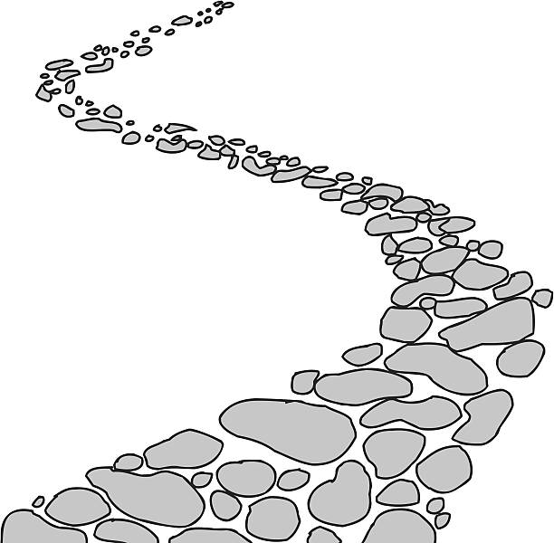
Walking the Path
~ Walking the Path of Reconciliation ~
Monday 26th February 2024
Brentwood Diocese Education Service

Slide 2
Walking the path of reconciliation
Across the barriers that divide people from each other: Reconcile us, O Christ, by your love.
Across the barriers that divide rich from poor: Reconcile us, O Christ, by your love.
Across the barriers that divide people of different races and cultures: Reconcile us, O Christ, by your love.
Across the barriers that divide Christians: Reconcile us, O Christ, by your love.
Across the barriers that divide men and women, young and old: Reconcile us, O Christ, by your love.
Enable us to see the causes of conflict,
remove from us all senses of superiority. Teach us to grow in unity with all God’s children.
BDES

Slide 3
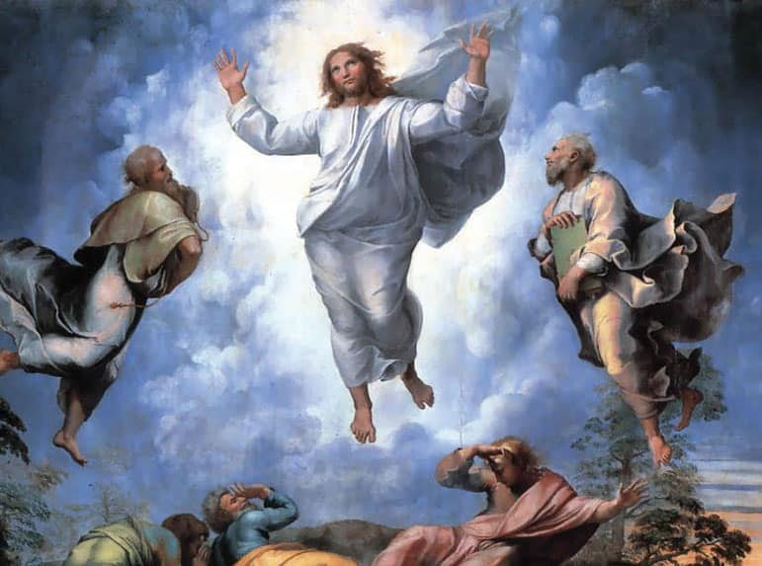
In Sunday’s Gospel Reading …
Sunday 25th February 2024 :
In the Gospel of Mark,
God speaks to us :
“This is my beloved Son. Listen to him.”
BDES

Slide 4
Women’s World Day of Prayer
I beg you,
bear with one another with love.
1st March 2024
BDES

Slide 5
Preparing for World Youth Day 2027
The very first truth
I would tell each of you is this :
“God loves you”.
- Pope Francis,
Christus vivit
BDES

Slide 6
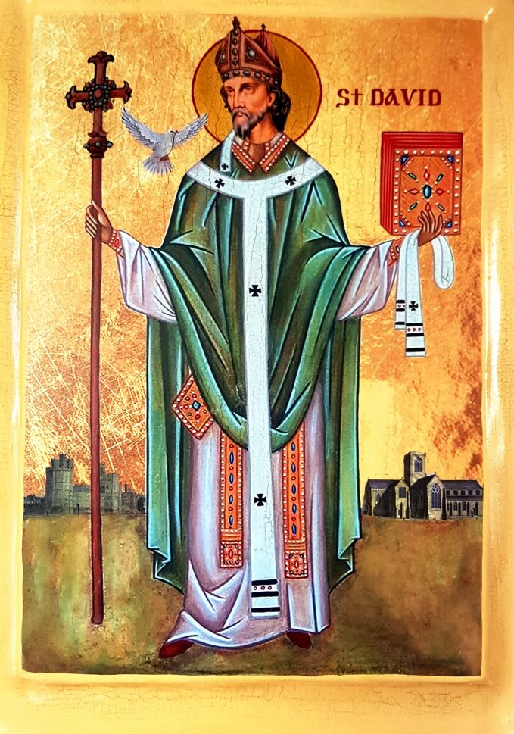
Saint David
National Feast Day
~ 1st March ~
“Gwnewch y pethau bychain” - “Do the little things”.
These are supposed to have been St David’s final words of advice on his deathbed, advice to live your life by small acts of kindness which together would make a large difference.
He is the patron saint of Wales and was a bishop there in the 6th century. He was a teacher, a preacher, a founder of monasteries and churches, an inspirational man who lived a simple life, and a visionary.
BDES

Slide 7
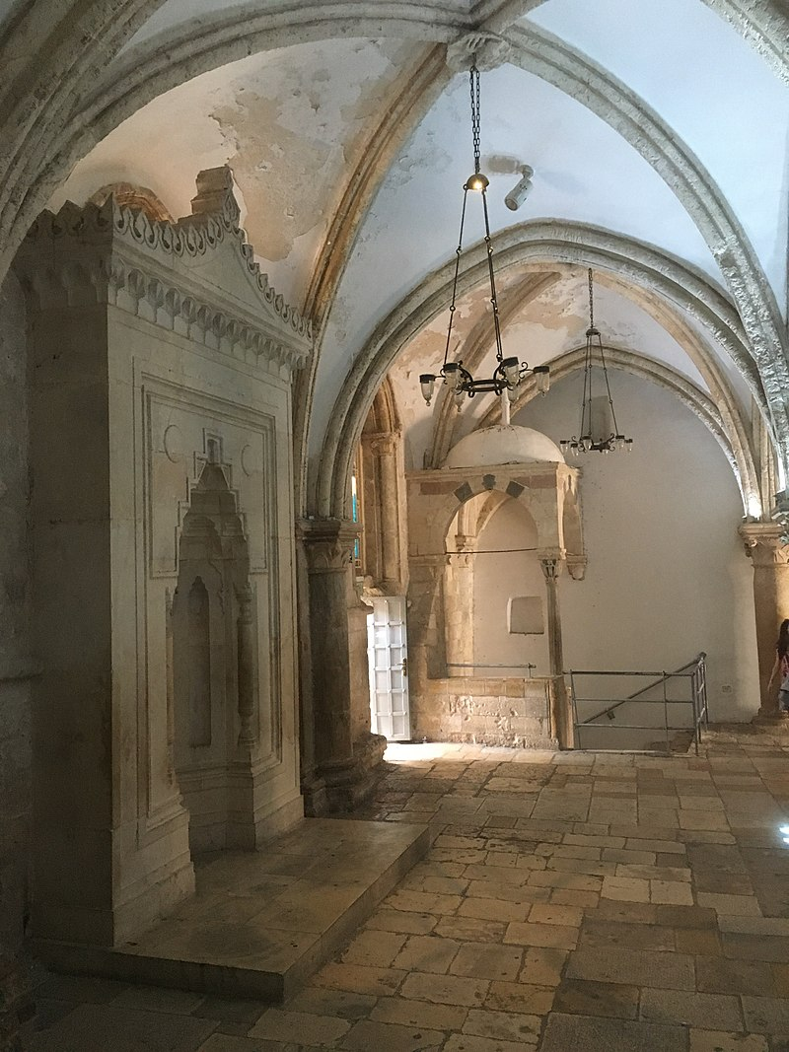
Jerusalem: Room of the Last Supper
The Cenacle (from the Latin cenaculum, “dining room”), also known as the Upper Room, is a room on Mount Zion in Jerusalem, traditionally held to be on the site of the Last Supper, the final meal that Jesus had with his apostles. The current room was built between the 12th-14th centuries.
According to tradition, the Cenacle was a place in which the apostles continued to gather after the Last Supper, and was where the Holy Spirit came down upon the apostles at Pentecost.
BDES

Slide 8
Walking the Path
~ Walking the Path of Reconciliation ~
Monday 26th February 2024
Brentwood Diocese Education Service

