Slide 1
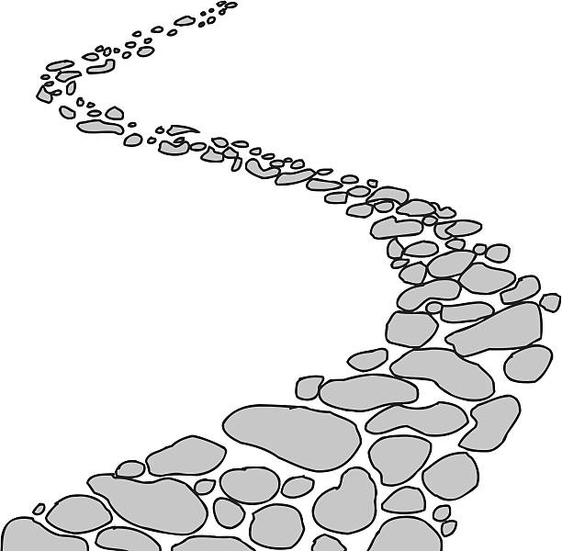
Walking the Path
~ Walking the Path of Gratitude~
Monday 5th February 2024
Brentwood Diocese Education Service

Slide 2
Walking the path of gratitude
On that day, you will say : I give you thanks, O Lord; God indeed is my salvation;
I am confident and unafraid. For the Lord is my strength and my might, and he has been my salvation. With joy you will draw water from the fountains of salvation, And you will say on that day: give thanks to the Lord, acclaim his name.
(Isaiah 12 : 1-6)
BDES

Slide 3
In Sunday’s Gospel Reading …
Sunday 4th February 2024 :
In the Gospel of Mark,
his friends tell Jesus :
“Everyone is looking for you.”
BDES

Slide 4
Reflection
Let us keep looking to Jesus.
He is the one who started this journey of faith.
And he is the one who completes the journey of faith.
He paid no attention to the shame of the cross.
He suffered there because of the joy he was looking forward to.
Then he sat down at the right hand of the throne of God.
(Hebrews 12 : 2)
BDES

Slide 5
Preparing for World Youth Day 2027
“Christ is alive and he wants you
to be alive!”
- Pope Francis,
Christus vivit
BDES

Slide 6
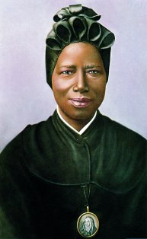
Saint
Josephine Bakhita
8th February
Saint Josephine (1869-1947) was born in Darfur in Sudan, captured by slave traders at the age of 7 and repeatedly sold and brutally treated. She was fortunate to be given into the care of the Canossian nuns in Venice where she encountered Christianity, converted and joined the community. Her personal holiness and her book “My Miraculous Story” were inspirational and continue to inspire today.
She was canonised in 2000 and is the patron saint of xxx victims of human trafficking.
BDES

Slide 7
Jerusalem: The Church of All Nations
Set against the background of the Mount of Olives, the Catholic Church of All Nations was built in 1924 in the neo-Byzantine style on the ruins of two previous churches.
It contains multiple mosaics representing the 12 nations that helped to fund it.
The church is actually built within the Garden of Gethsemane, still full of olives – some of which have been dated to be around 2,000 years old and may have been young saplings at the time Christ was arrested in the Garden.
BDES

Slide 8
Walking the Path
~ Walking the Path of Gratitude~
Monday 5th February 2024
Brentwood Diocese Education Service

