Slide 1
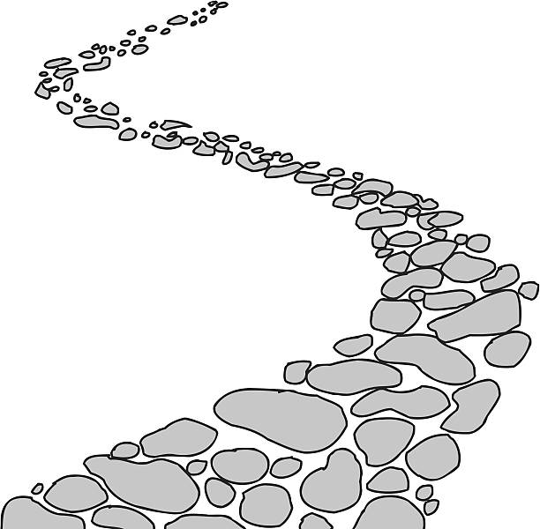
Walking the Path
~ Walking the Path of Gratitude~
Monday 29th January 2024
Brentwood Diocese Education Service

Slide 2
Walking the path of gratitude
Racial Justice
Our unique ancestries are a gift.
The world has been blessed with
such a broad diversity of cultures
and perspectives, knowledge, skills and experiences.
Working with different people to ourselves
should feel like being in a sweet shop.
All cultures should be seen for what they are,
a gift from God.
BDES

Slide 3
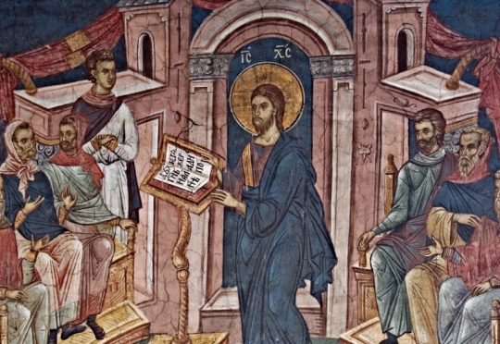
In Sunday’s Gospel Reading …
Sunday 28th January 2024
In the Gospel of Mark, the people ask :
“What is this new teaching?”
BDES

Slide 4
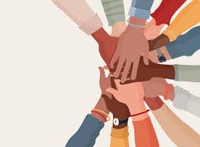
Reflection
God of justice and peace,
May we see Your beauty in each one of Your dear children, Recognising the fingerprints of a loving God
Who made all of us in the image of the Divine.
Knowing deeply that it was You, O God,
Who breathed life and beauty into us all.
May we welcome one another here today, and
May we welcome Your children into our communities
With the same passion and zeal that we welcome
Your presence with us.
BDES

Slide 5
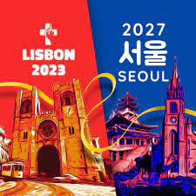
Preparing for World Youth Day 2027
“Christ is alive!
He is our hope,
and in a wonderful way he brings youth to our world.”
- Pope Francis,
World Youth Day, 2023
BDES

Slide 6
Memorial of St. Blaise: 3rd February
In the General Calendar on 3rd February is the memorial of St Blaise : it is permitted to bless throats with unlit candles using the following prayer. “Through the intercession of St Blaise, Bishop and Martyr, may God free you from disease of the throat and from every other evil, in the name of the Father, and of the Son, and of the Holy Spirit, Amen.
xxx(from the Brentwood Diocesan Directory, 2024)
Blaise was a hard-working bishop dedicated to encouraging the spiritual and physical health of his people in Sebastea, Armenia. Although the Edict of Toleration which granted freedom of worship in the Roman empire had been signed five years previously, religious persecution still raged in the country. According to a legend, a mother came to him with her young son who had a fish bone lodged in his throat. At Bishop Blaise's command, xxxxxxxx the child coughed up the bone. In 316 he was beheaded for not sacrificing to the pagan gods.
BDES

Slide 7
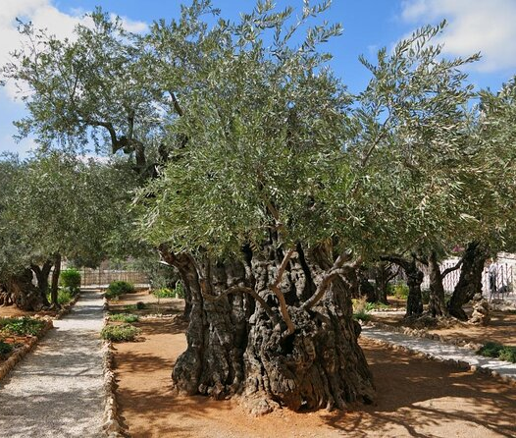
Jerusalem: Garden of Gethsemane
The Garden of Gethsemane (the Garden of the Olive Oil Press)
is a walled garden on the lower slopes of the Mount of Olives, opposite the Old City of Jerusalem. According to the Gospels, it was there that Jesus underwent His Agony in the Garden, was betrayed by His friend Judas and arrested by an armed detachment sent by the High Priest. You can go there and look through the protective bars to see ancient olive trees, some of which may possibly date to the time of Christ …
BDES

Slide 8
Walking the Path
~ Walking the Path of Gratitude~
Monday 29th January 2024
Brentwood Diocese Education Service

