Slide 1
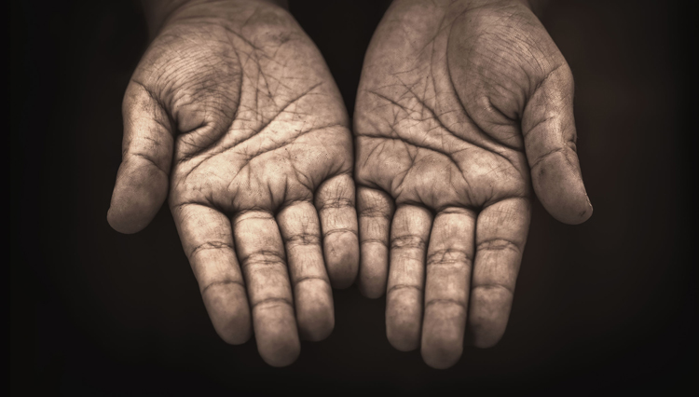
VISIO DIVINA
Brentwood Diocese Education Service

Slide 2
VISIO DIVINA
Brentwood Diocese Education Service

Slide 3
The Sign of the Cross
BDES

Slide 4
Opening Prayer
Holy Spirit we invite you here today to fill our hearts and minds with Your presence and to speak to our hearts the words that You have for us.
BDES

Slide 5
VISIO DIVINA
Brentwood Diocese Education Service
Notes:
Gaze upon the image. Give it some time. Think about your initial reaction. How does it make you feel? What does it say to you today?

Slide 6
• Visio•
He was in the world, and
though the world was made
through him, the world did
not recognize him.
John 1:10
BDES

Slide 7
• MEDITATIO •
REFLECTION
What God is saying to you?
Feel free to share. If you wish, please say why.
BDES

Slide 8
• MEDITATIO •
BDES

Slide 9
• ORATIO •
PRAYER
What would you like to say to God?
……..
Lord in your mercy …
R / Hear our prayer
BDES

Slide 10
• ORATIO •
BDES

Slide 11
• Visio•
He was in the world, and
though the world was made
through him, the world did
not recognize him.
John 1:10
BDES

Slide 12
• CONTEMPLATIO •
LET US
REST IN GOD
IN SILENCE
BDES

Slide 13
The Lord’s Prayer
BDES

Slide 14
• ACTIO •
BDES
Notes:
Consider how you’ll take this into your life.

