Slide 1
Looking Forward
~ We are an Easter People ~
Monday 26th April 2021
Brentwood Diocese Education Service

Slide 2
We are an Easter People
~ In the Year of St Joseph ~ In the Year of the Family ~
Every year at Easter, the Pope – as Bishop of Rome – delivers his message and blessing to the City of Rome and to the whole world (Urbi et Orbi). In 2020 and in 2021, he had to do so from inside St Peter’s Basilica due to Covid restrictions, rather than to the crowds in St Peter’ s Square.
This year, Pope Francis preached how the Risen Christ gives hope for those suffering from the pandemic, the sick and those who have lost a loved one. He stressed that everyone has a right to be cared for.
“The Risen Lord is a comfort,” said Pope Francis. We are an Easter people.
We are people who look forward in hope.

Slide 3
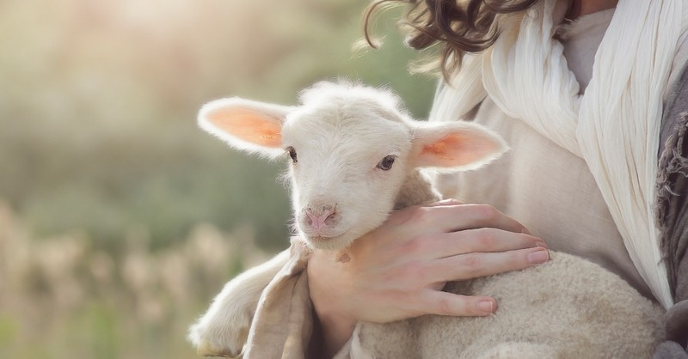
The Synoptic Problem
In Sunday’s Gospel Reading …
25th April 2021 :
4th Sunday of Easter
“I am the Good Shepherd.”
BDES

Slide 4
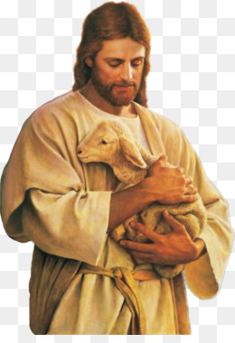
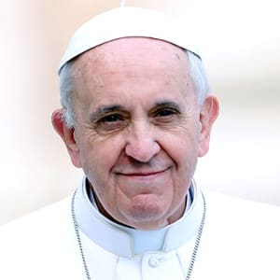
The Synoptic Problem
Reflection : Being a Good Shepherd
everyone has a right to be cared for
Everyone has a right to be cared for
I am the Good Shepherd
BDES

Slide 5
The Synoptic Problem
Reflection : Being a Good Shepherd
everyone has a right to be cared for
Everyone has a right to be cared for
I am the Good Shepherd
How can I show care? How can I imitate Christ?
BDES

Slide 6
Preparing with our families for World Youth Day 2023
“Please. Thank you. Sorry.
If in a family environment there are
these three words,
the family is fine.”
- Pope Francis on the Year of the Family
BDES

Slide 7
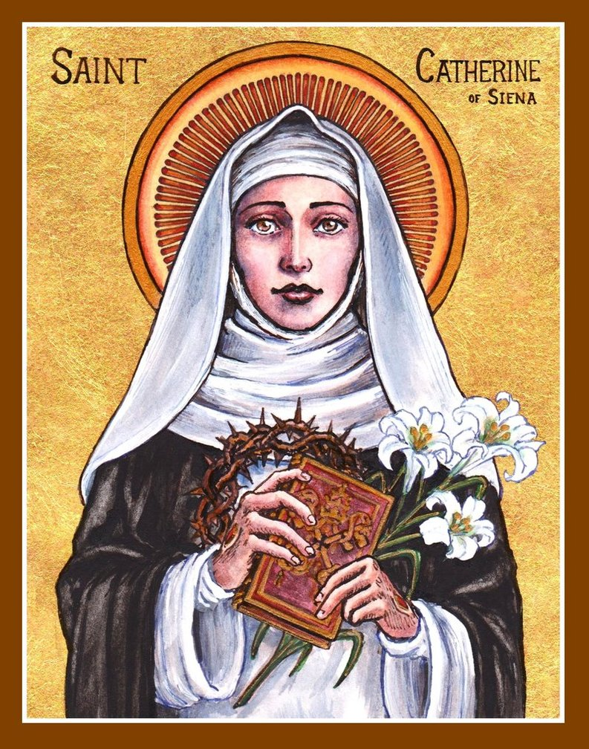
Saint Catherine of Siena
Feast day : 29th April
Catherine was a lay member of the Dominican order. She was famous as a mystic, an activist and an author. She might be described as the original “influencer”! She influenced popes and princes and cardinals with her letters, of which she wrote hundreds. She wrote numerous prayers, and a set of spiritual treatises collected together as a book under the title The Dialogue of Divine Providence. She was even sent on missions by the Pope, something extraordinarily rare for a woman in the 14th century!
BDES

Slide 8
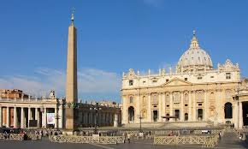
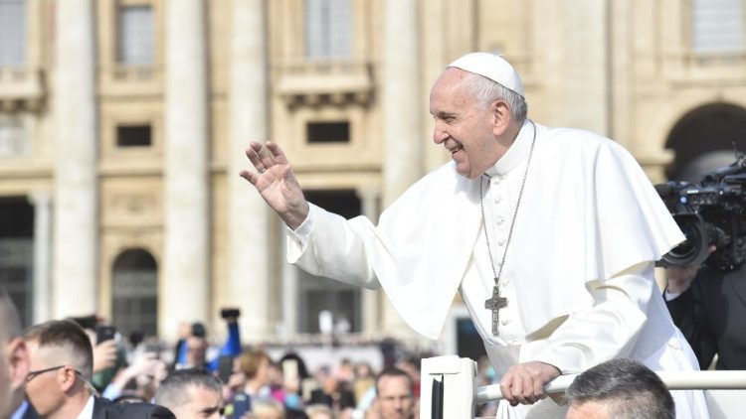
Looking forward : pilgrimage focus
At the moment, we can only dream of travel abroad. Perhaps in your dream plans you might consider a truly amazing place of pilgrimage, the Holy City. It has over 900 churches, including the Basilica of St Peter built over the tomb of Jesus’ friend and disciple. It contains Vatican City, the mini-state home of the Pope.
• ROME •
Every Wednesday morning, the Pope holds a General Audience in St Peter’s Square and speaks to pilgrims from across the world in a number of languages – including English!
Perhaps for the moment you can find out about the amazing sites and sights of Christian Rome xxxxxx from the comfort of your electronic devices…
BDES

Slide 9
Looking Forward
~ We are an Easter People ~
Monday 26th April 2021
Brentwood Diocese Education Service

